Slide 1
World History
Pegasus California School

Slide 2
Agenda
Chinese History
Qin Dynasty
Han Dynasty
  KWL

Slide 3
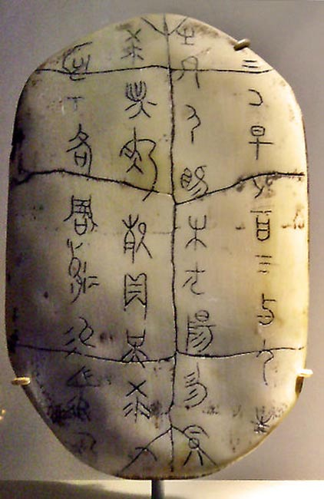
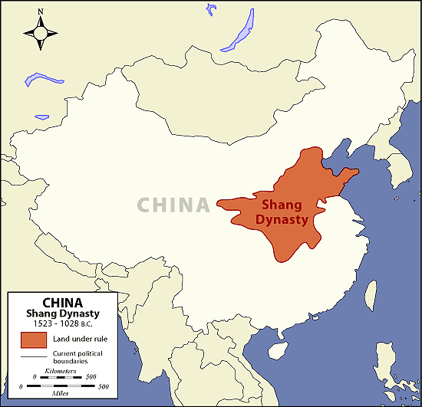
Shang Period (1750-1045BCE)
Neolithic societies farmed and domesticated animals in Northeastern part of China
  Yellow River valley region
Earlier period?
  Possibility of a Xia dynasty before, but no legitimate records exist of this period except from the Zhou
Writing system implemented during this time
  Written on oracle bones for divination (evidence of culture and religion)

Slide 4
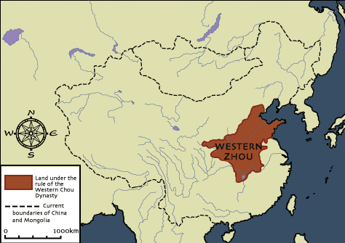
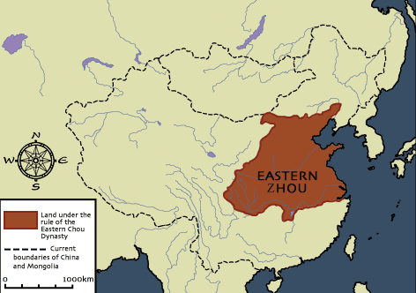
Zhou Period (1045-221BCE)
Western Zhou (1045-771BCE)
  King Wu defeated the Shang and established the Zhou. He stated he had the right to rule due to the Mandate of Heaven (天命 Tian Ming): the religious and political right to rule
Eastern Zhou (770-221BCE)
  Feudal division of territory and power causes independent states & Zhou rulers became weak

Slide 5
Warring States Period of the Late Zhou (490BCE – 221BCE)
The Spring and Autumn Period (771-476BCE)* saw a gradual decline in the power of the Zhou Dynasty
  Many officials of various regions gained power over their territories
  Many different philosophies spread and discussed appropriate rule (review: Confucianism/Daoism/Legalism)
*To give a reference for a time context:
Rome was founded in 753BCE and became a Republic in 509BCE

Slide 6
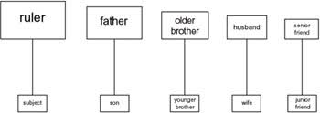
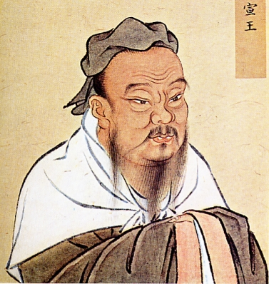
Confucianism (550BCE)
Founder – Kong Zi (Late Zhou)
Basic ideas:
  Respect and take care of one another
  Listen to and trust your elders, especially in your family (older siblings, parents, grandparents)
    Old people are wise! They have been around and have experienced many things and listening to them is helpful!
  Listen to and trust your government/leaders
    Your leaders are benevolent and kind (as long as they follow the Confucian ideals!)
  Education is important for society

Slide 7
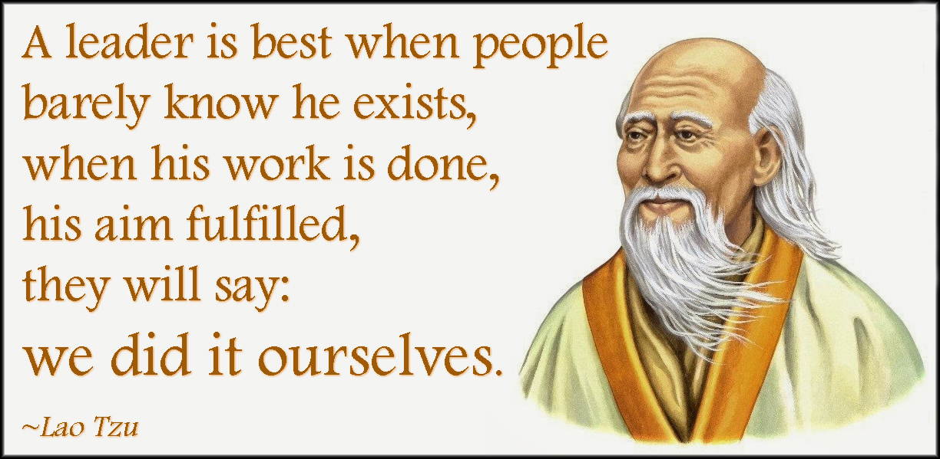

Daoism (600BCE)
Founder – Lao Zi(Late Zhou)
Basic ideas:
  Existence is guided by opposing forces
    “Defeat hardness with softness”
    “A bowl is most useful when it is empty”
  Look to nature for guidance (or reversely, nature guides us)
    Nature is ever changing and we must understand and change with it
    “The more laws imposed, the more thieves and bandits there will be”

Slide 8

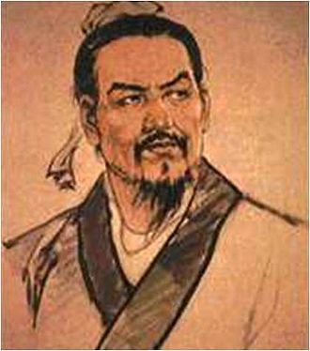
Legalism (370-ish BCE)
Founder – Unsure, but most famous is Shang Yang and Han Fei
Basic ideas:
  Legalist reasoning -
    Man is selfish and evil
    Selfishness and evil need to be controlled
    It is the government’s job is to control man
  People must follow rules established by the leader/government
    Harsh punishment for breaking the rules to set an example for others (killing the chicken to scare the monkeys)

Slide 9
Situation
A young man is caught stealing from a neighbor (stealing is illegal!). When asked why, the young man said his elder brother asked him to take the medicine from the neighbors house because their father is sick and they have no money
What would a _______ say in this situation?
  - Confucian
  - Daoist
  - Legalist

Slide 10
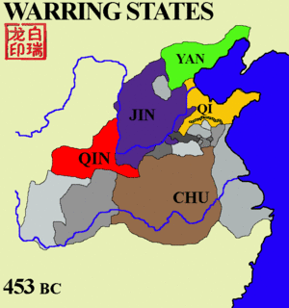
Warring States Period of the Late Zhou (490BCE – 221BCE) cont.
The late Zhou period had territories divided into 7 states by 334BCE
  Qin, Han, Wei, Zhao, Qi, Chu, Yan (& some smaller states)
  Eventually, King Zhao Zheng dominates and establishes a the Qin Dynasty in 221BCE

Slide 11
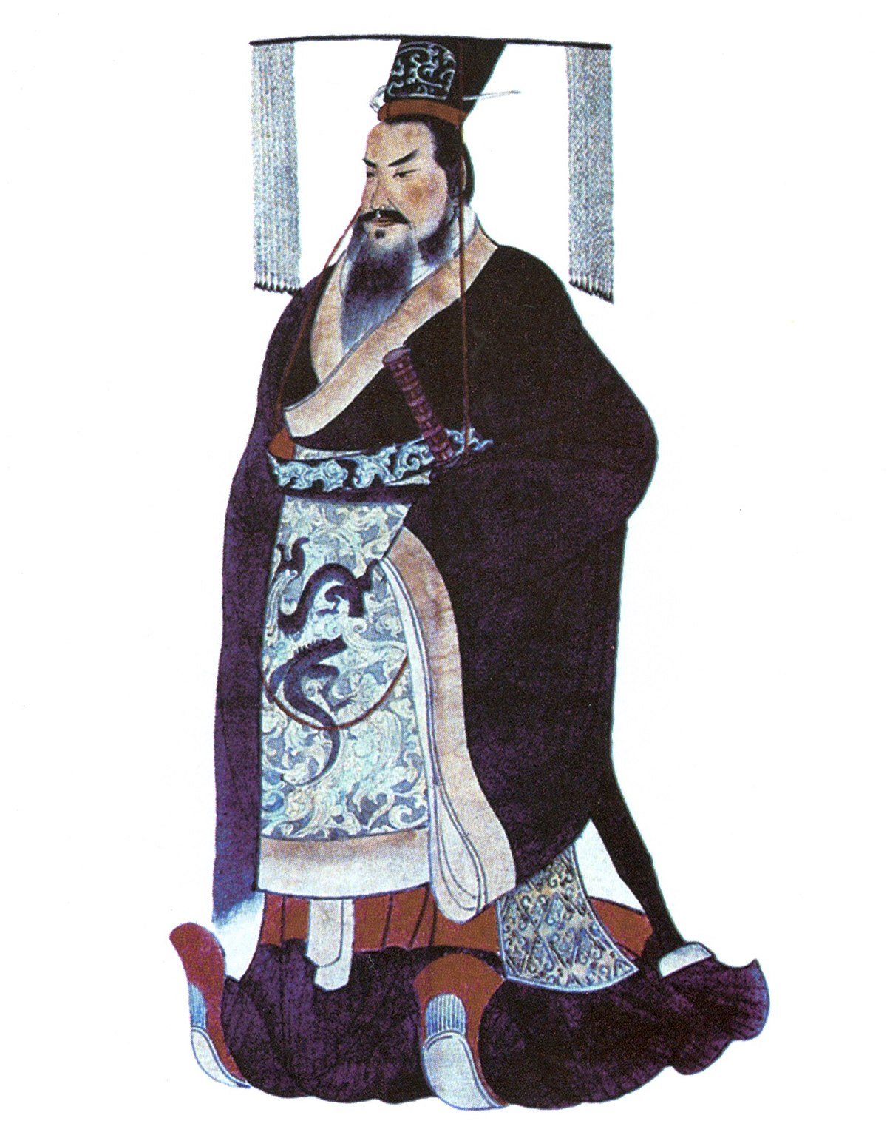
Qin Dynasty (221-206BCE)
秦
Zhao Zheng renames himself Qin Shi Huang [First Emperor of Qin]
Establishes Legalism as the philosophy of the land
Centralized government & harsh changes
  The Emperor had major power
  Destroyed relics of the past and killed many who disagreed with the philosophies
    What is legalism’s criticism of the past?

Slide 12
Excerpt from “Records of the Grand Historian (Shiji)” by Sima Qian, 94BCE*
Chancellor Li Si Said: "I, your servant, propose that all historians' records other than those of Qin's be burned. With the exception of the academics whose duty includes possessing books, if anyone under heaven has copies of the Shi Jing [Classic of Poetry], the Shujing [Classic of History], or the writings of the hundred schools of philosophy, they shall deliver them (the books) to the governor or the commandant for burning. Anyone who dares to discuss the Shi Jing or the Classic of History shall be publicly executed. Anyone who uses history to criticize the present shall have his family executed. Any official who sees the violations but fails to report them is equally guilty. Anyone who has failed to burn the books after thirty days of this announcement shall be subjected to tattooing and be sent to build the Great Wall. The books that have exemption are those on medicine, divination, agriculture, and forestry. Those who have interest in laws shall instead study from officials."
*What can time context tell us about possible biases?

Slide 13
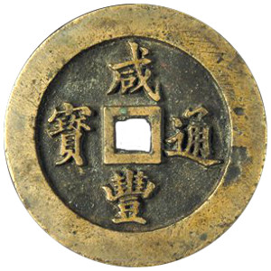
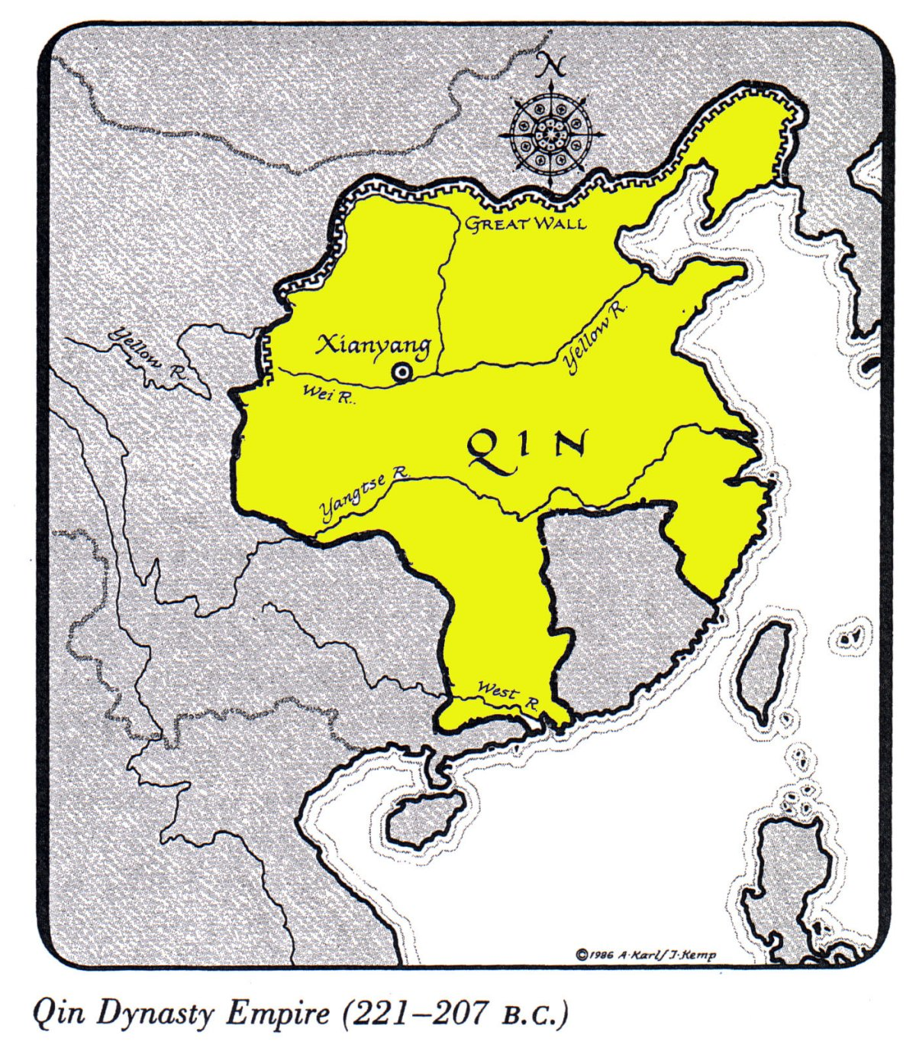
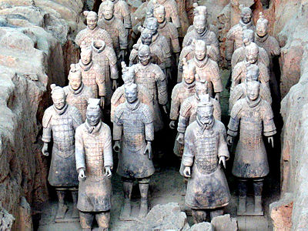
Achievements of the Qin Dynasty
Qin Empire expanded quickly
Standardized coinage and currency
Construction Projects
  Start of The Great Wall (originally as protection from northern tribes)
  Building of roads
  Terracotta Army

Slide 14
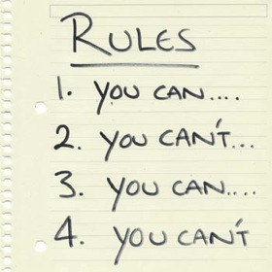
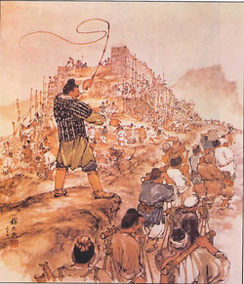

Decline of Qin Dynasty
Heavy taxes of citizens
  Costs of large government, large armies, and construction projects
Harsh rule and strict rules
  Legalism irritated the people
Weak successor
  Qin Shi Huang dies from mercury poisoning
  His son, Qin Er Shi, ruled only three years before he committed suicide in 207BCE
Nationwide rebellions led to the overthrow of the Qin in 206BCE

Slide 15
HAN Dynasty (Know & Want to Know)

Slide 16
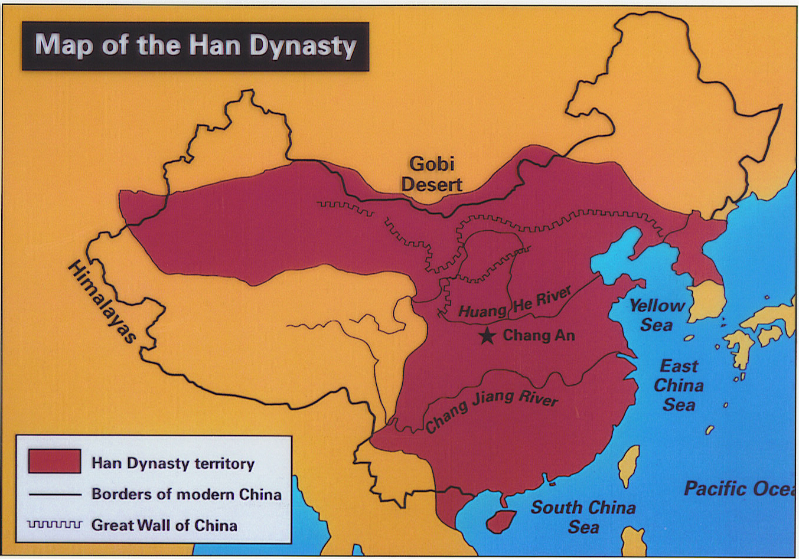
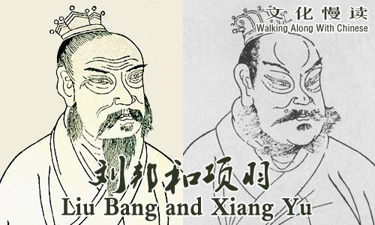
Battle for China: Xiang Yu vs. Liu Bang [v]
In a series of battles, Xiang Yu and Liu Bang brought their armies against each other
  Both were former allies fighting against the Qin, but there can only be one ruler of China
  Both fought to control China after the fall of the Qin
Liu Bang succeeded and defeated Xiang Yu in 202BCE

Slide 17
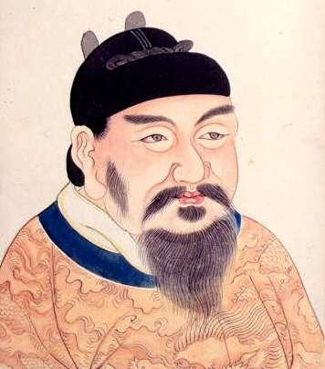
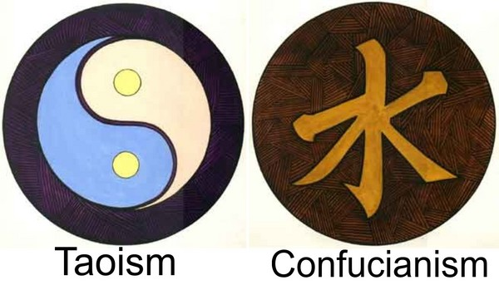
Han Dynasty (206BCE – 220CE)
汉
Emperor Gaozu (formerly Liu Bang) establishes the Han Empire
Peasant Background
  Was said to have come from humble beginnings and grew his reputation
Centralized Government
  Similar to Qin, no?
Criticized and removed Legalist ideas
  Why is this a popular move for Gaozu?
Re-establishes Confucian and Daoist practices

Slide 18
Han Dynasty Social Structure
Social structure from Most to Least powerful
Questions:
Where are the soldiers?
  Farmers were typically conscripted to fight one month out of the year
Why are we not using a pyramid?
  Because the population distribution is not proportional (ex: slaves made up only 1% of population)
How is this social structure similar to the structure of the Early Zhou?
  Farming was seen as a more respectable profession (than Artisans and Merchants) as they helped feed the 60 million Han people
    Remember ‘peasant’ Liu Bang?
Emperor
Royalty and Royal Family
Farmers
Scholars and Officials
Artisans and Merchants
Slaves

Slide 19
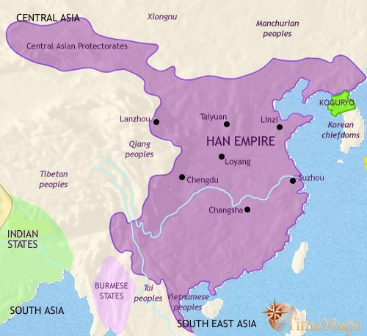
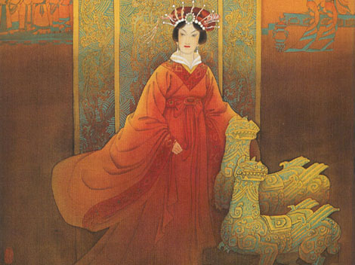
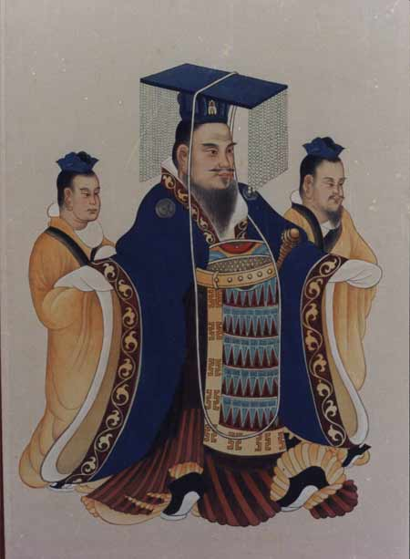
Gaozu’s Successors
His wife, Empress Lü, became Empress Dowager in 195 BCE after Gaozu’s death
  Rumored to have ordered the deaths of Gaozu’s favorite concubine and their son (poison)
  Had much influence over her son’s rule
His great grandson, Wudi, reigned from 141 – 87 BCE
  Fought off the Xiongnu tribes of the north
  Established colonies in present-day Vietnam, Korea, and central Asia

Slide 20
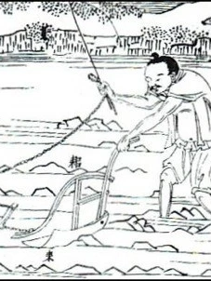
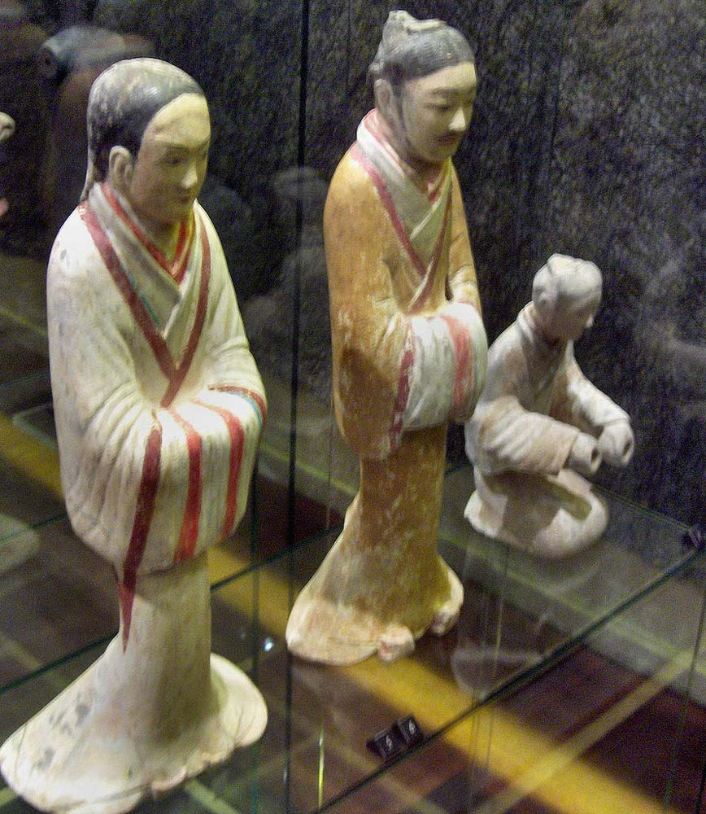
Han Problems: Economy
Wealthy people tended to be landowners and nobles
  Some didn’t have to pay taxes because they were friends or family to royalty
Farmers typically tenant farmers and didn’t own land
  50% of their income went to paying the nobles
Han Dynasty’s Inheritance Law
  Land is divided amongst the male heirs
  Over time, plots of lands became smaller and smaller; farmers could not grow much but were still taxed heavily
Salt and Iron monopoly (gov’t controlled all)
  Industries (merchants, farmers, laborers, military, etc.) using salt and iron had to pay set prices
  Reduction in quality of items

Slide 21
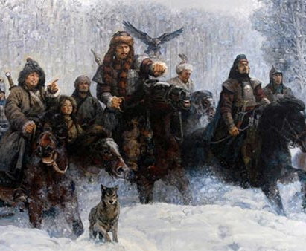
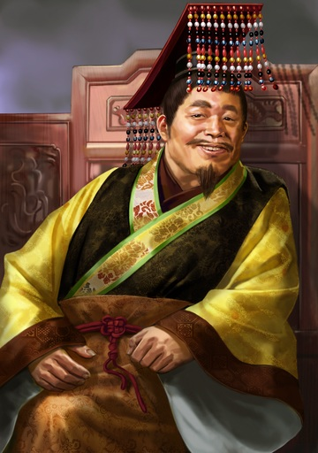
Han Problems: Invasions and Weak Rulers
The nomadic Xiongnu tribes of the north kept attacking the borders of Han Empire
  Other tribes like the Uighers and Kazahks of the west, and the Mongols and Jurchens of the north and northeast
Weak Emperors of the Han create decline in the Empire
  Emperor Yuan (48-33 BCE) brought Confucianism into Han but was extremely indecisive
  Emperor Ling (168-189 CE) lived a decadent lifestyle and didn’t want to be Emperor

Slide 22
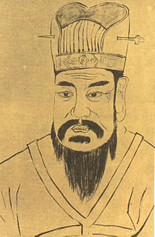
Wang Mang and the shortest-lived Chinese dynasty
Wang Mang was the nephew of the Grand Empress Dowager
  Was the regent to Emperor Ping, the 9-year-old Han Emperor, in 1CE
Ping dies in 5CE, and Wang Mang serves as acting emperor
Becomes Emperor of the Xin Dynasty in 9CE
  Wang Mang’s rule splits the Han into two periods:
    The Western Han (206BCE – 9CE)
    The Eastern Han (25CE – 220CE)

Slide 23
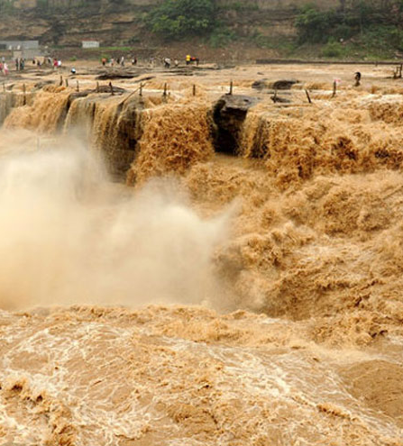
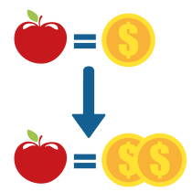
Xin Dynasty: Wang Mang doesn’t have the mandate of heaven
Economic Problems
  Tried to create more money to pay for high costs of Empire but ends up creating an inflation (money becomes devalued)
Tried to feed the poor
  But with what money?
Land Inheritance Reform
  Attempts at redistribution of lands marks Wang Mang as an enemy to the aristocratic land owners
Discontinued tributes to the invaders
  Not sending gifts to the Xiongnu and other tribes meant more attacks on the people (peasants)
The flood of the Yellow River in 11CE led to the lost of homes and businesses but also deaths due to disaster and famine

Slide 24
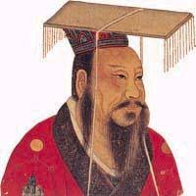
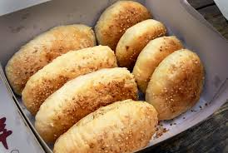
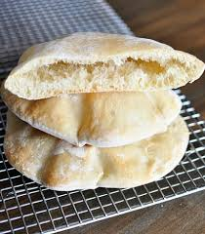
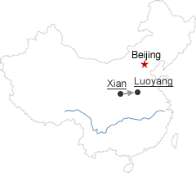
End of Xin and the Eastern Han
Rebellions arise all over China during the Xin Dynasty
  In 23CE, Wang Mang is assassinated in Weiyang Palace
In 25CE, the Han Dynasty was re-instituted under Emperor Guangwu (Eastern Han)
  The capital was moved from Chang’an to Luoyang
Food(V)
  It is said that the ‘shaobing’ was brought from military expansion of China towards Central Asia
  The diet of the Han peoples consisted of wheat, rice, barley, millet, and beans
Middle-Eastern Pita bread for comparison

Slide 25
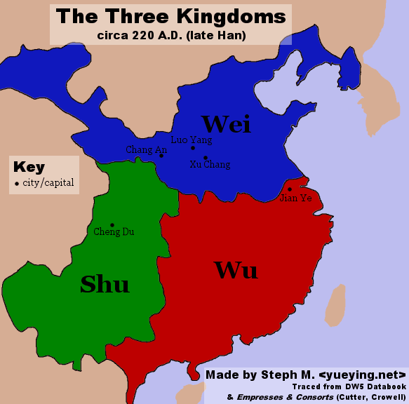
End of the Eastern Han
Unfortunately, the same economic problems will continue to persist which will lead to the end of the Han in 220 CE
  China will be broken into the Three Kingdoms of Wei, Wu, and Shu

Slide 26
Timeline!
You’ll be given an event. Do the following:
Find the year the event happened
Determine if it’s a Roman or Han Chinese
Write a one-sentence summary of this event
Establishment of the Han Dynasty (Eastern) | Death of Julius Caesar | Cai Lun Invents Paper | Battle of Gaixia | Qin Dynasty Established | Establishment of the Roman Republic
Death of Tiberius Gracchi | Zhang Qian Returns to Chang’an | Battle of Red Cliffs | Colosseum Completed | Establishment of the Roman Empire | End of the Punic Wars
The Roman Empire Divided into Two | Fall of the (Western) Roman Empire | Sima Qian Writes the Shiji | Fall of the (Eastern) Han Dynasty | Law of the Twelve Tables Completed | Wang Mang Establishes Xin Dynasty

Slide 27
Establishment of the Han Dynasty (Eastern) | Death of Julius Caesar | Cai Lun Invents Paper | Battle of Gaixia | Qin Dynasty Established | Establishment of the Roman Republic
Death of Tiberius Gracchi | Zhang Qian Returns to Chang’an | Battle of Red Cliffs | Colosseum Completed | Establishment of the Roman Empire | End of the Punic Wars
The Roman Empire Divided into Two | Fall of the (Western) Roman Empire | Sima Qian Writes the Shiji | Fall of the (Eastern) Han Dynasty | Law of the Twelve Tables Completed | Wang Mang Establishes Xin Dynasty

Slide 28
Establishment of the Han Dynasty (Eastern) 25CE [C] | Death of Julius Caesar 44BCE [R] | Cai Lun Invents Paper 104CE [C] | Battle of Gaixia 202BCE [C] | Qin Dynasty Established 221BCE [C] | Establishment of the Roman Republic 509BCE [R]
Death of Tiberius Gracchi 132BCE [R] | Zhang Qian Returns to Chang’an 125BCE [C] | Battle of Red Cliffs 208CE [C] | Colosseum Completed 70CE [R] | Establishment of the Roman Empire 27BCE [R] | End of the Punic Wars 146BCE [R]
The Roman Empire Divided into Two 285CE [R] | Fall of the (Western) Roman Empire 476CE [R] | Sima Qian Writes the Shiji 91BCE [C] | Fall of the (Eastern) Han Dynasty 9CE [C] | Law of the Twelve Tables Completed 450BCE [R] | Wang Mang Establishes Xin Dynasty 9CE [C]

