Slide 1
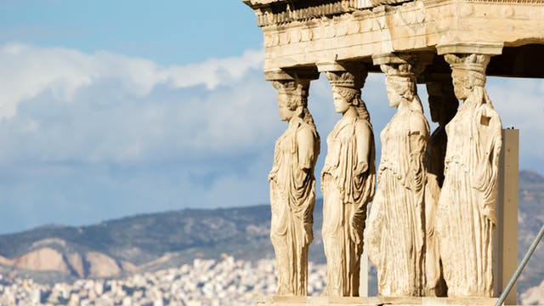
Ancient Greece
World History w/ Mr. Ng
2018-2019

Slide 2
It may be beneficial for you to write these down…
Vocabulary
Myceneans
Minoans
Pantheon
Aegean Sea
Questions to Consider
Describe 2 traits about Greece’s geography
What does Greece’s geography tell us about the people?
Who were the early settlers of Greece?
What is the Greek Pantheon?

Slide 3
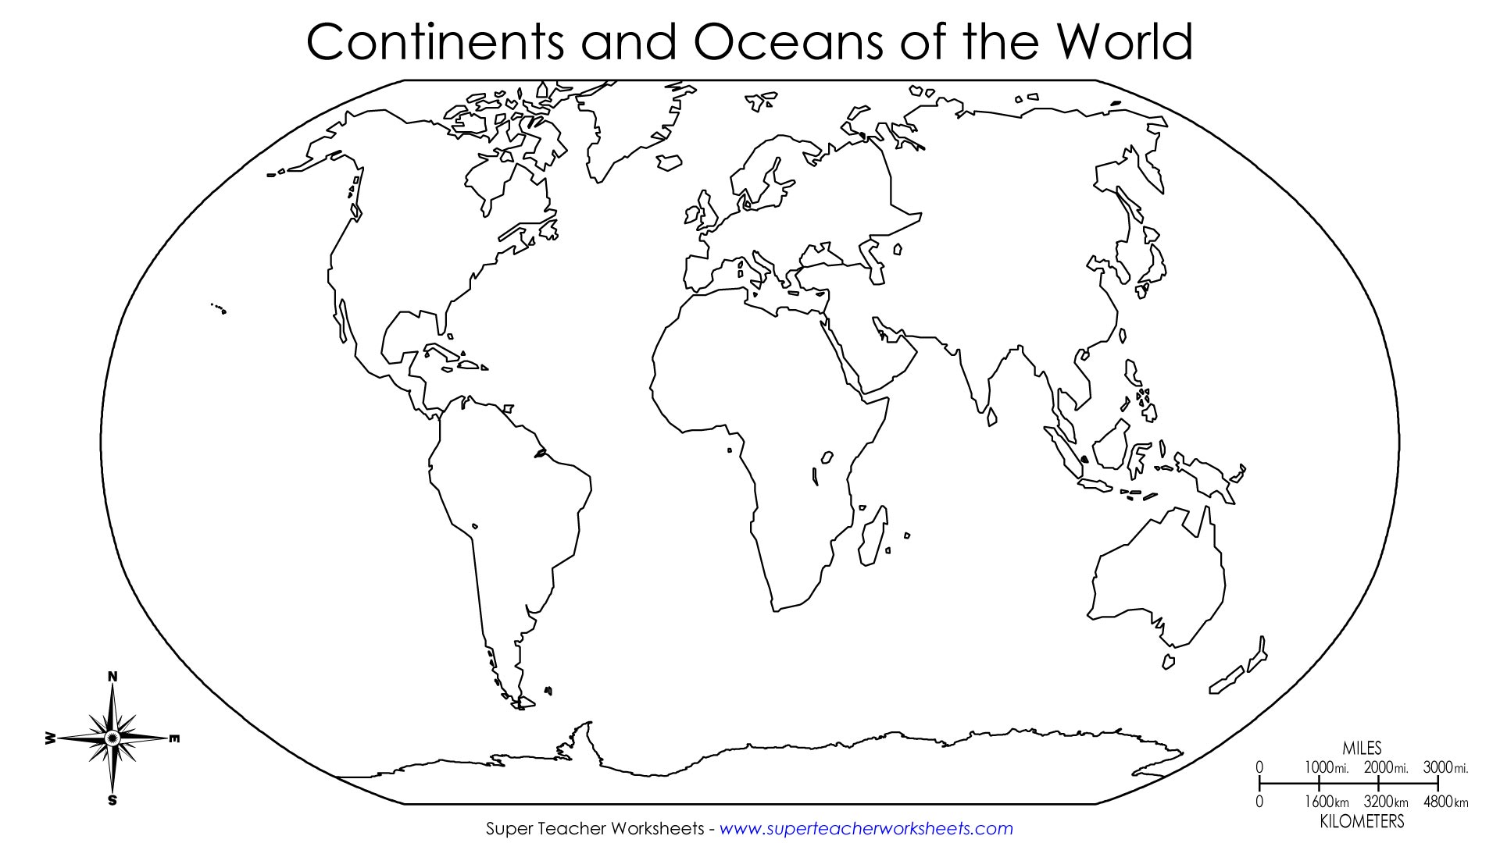
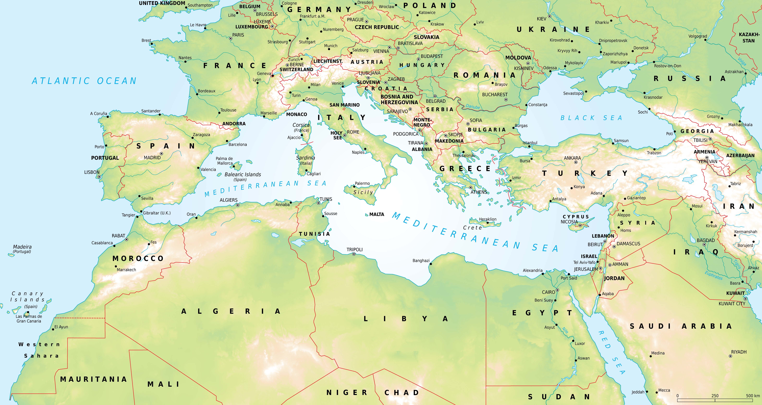
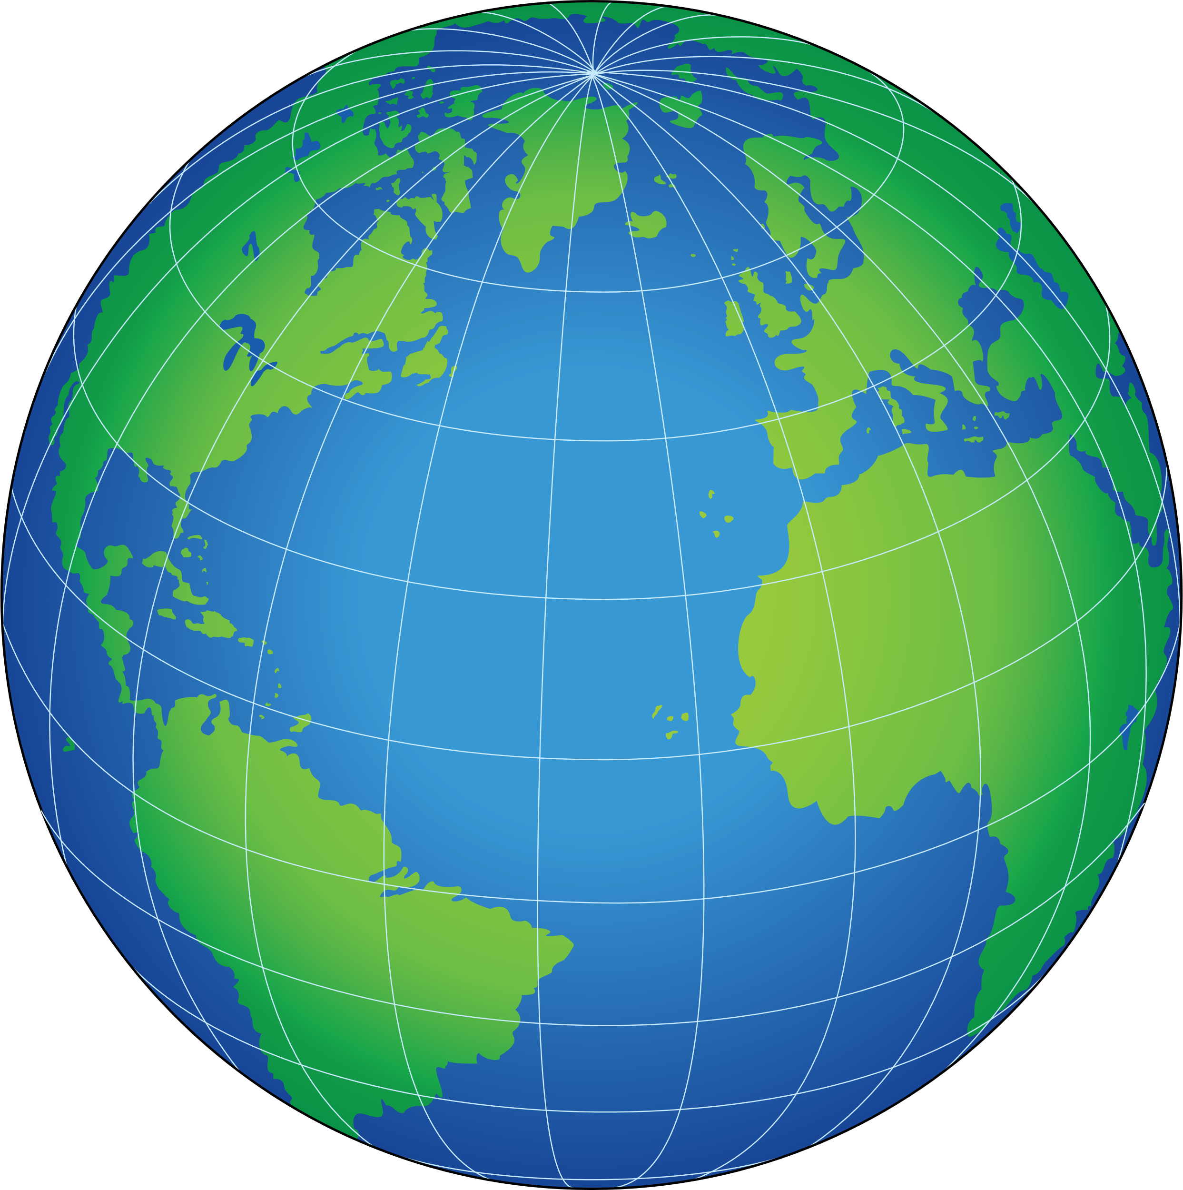
Where in the world is Greece?
Notes:
First, show image 1 and divide until we’ve honed in on the section
Second, show Mediterranean map and hone in
Then, pull up Google Earth and do a search on the globe

Slide 4
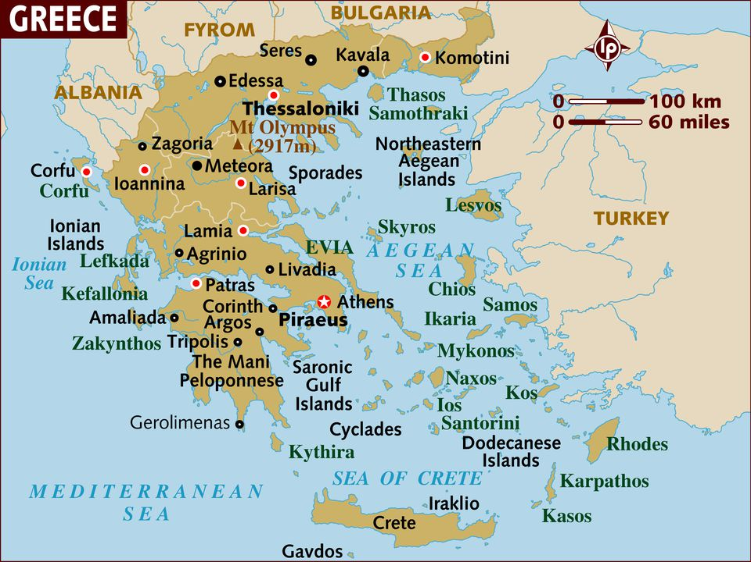
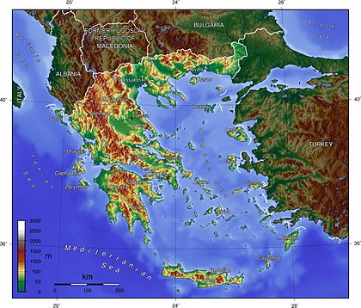
Greece: General Info
Greece is on the eastern Mediterranean Sea
  The body of water associated to it is called the Aegean Sea
Greece is known for its many islands
  1000-6000 islands
Greece is generally very mountainous
  It’s about 80% of Greece’s landscape
Q: From this geographic analysis, what assumptions do you have about Greece and Greek peoples (lifestyle, diet, movement, communication)
Notes:
A:
The mountainous terrain makes farming difficult so both agriculture and seafood and trade are important
Much travelling by water, so likely ship experts
Localized groups in individual areas. Relatively independent

Slide 5
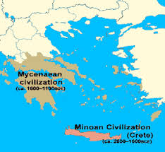
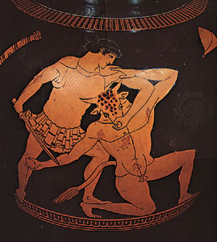
Greece: Early Peoples
Two early civilizations of Greece were called the Minoans and the Myceneans
  The Minoans lived on the big island of Crete from 3000-1100BCE and had a developed culture (art, stories, writing)
    Famous myth of a creature who lived underneath King Minos’ palace; a creature with a man’s body and a bull’s head
  The Myceaneans conquered the Minoans in 1400BCE from northern Greece and adopted much of Minoan culture
Much of Greek culture derives from the Minoans and Myceaneans

Slide 6
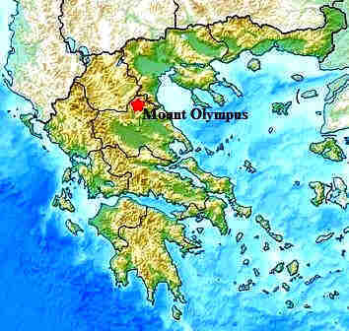
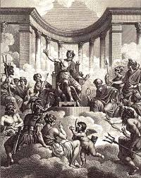
The Greek Gods
The Greek people believed in a Pantheon of Gods ( who lived on the top of Mount Olympus
  These Gods overthrew the creator Gods (Titans) and controlled different things (nature, luck, life/death, seas, etc.)
  Unlike many other religions, the Greek Gods are often involved in the lives of humans and are themselves human-like

Slide 7
Your Homework – Greek Character Posters
Artemis | Hercules | Hades | Zeus
Nike | Hypnos | Demeter | Hera
Hermes | Aphrodite | Poseidon | Ares
Hades | Hephaestus | Athena
Create a poster on A4 paper and include the following information:
  Name of Greek Mythical Character
  List their Power(s) (God of…)
  Relatives (Who’s their father/mother, brother(s)/sister(s))
  Symbol or Picture of character
Use Encyclopedia Britannica for information. Nothing else!
Use Color!

Slide 8
It may be beneficial for you to write these down…
Vocabulary
City-State/Polis
Acropolis
Athens
Sparta
Trireme
Phalanx
Greco-Persian War
Delian League
Questions to Consider
How is a city-state different from a city or a country?
What are the major differences between Athens and Sparta?
What was the Greco-Persian War?
How does the war end and how does it affect the balance of power in Greece afterwards?

Slide 9
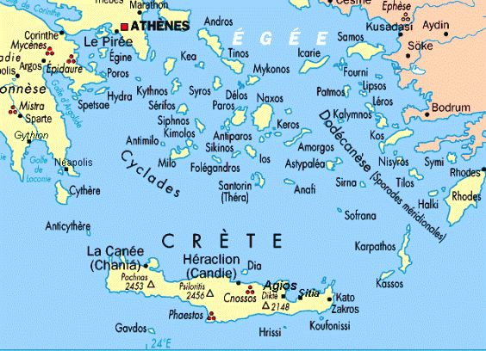
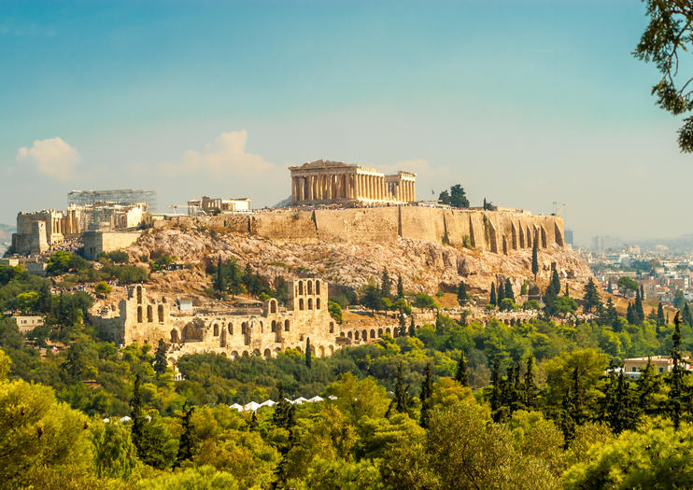
Rise of the Greek City-States
Due to the geography of Greece, many areas were independent from one another
These areas developed into their own Polis or City-States
  A city-state is like a city, but each has its own independent government and rule
Acropolis are city-states but typically built on higher ground or on a hill

Slide 10
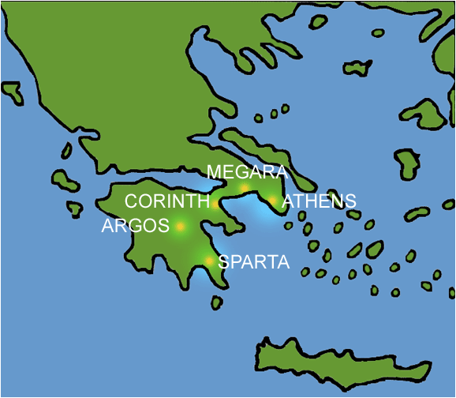
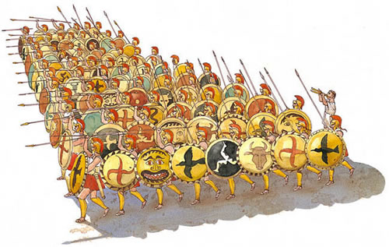
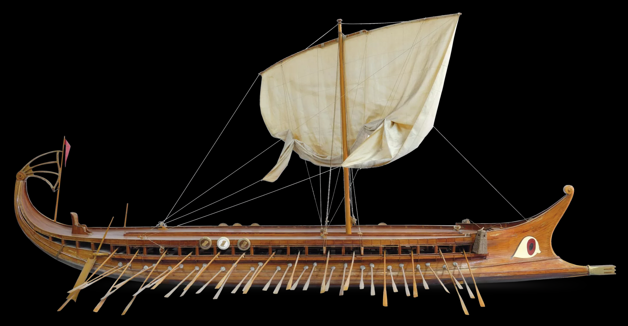

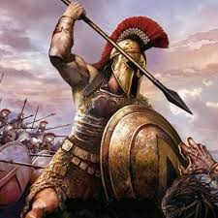
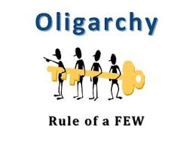
Two Famous Greek Polis’: Athens & Sparta
 | Athens | Sparta
Gov’t Style | Democracy | Oligarchy
Ruler(s) | Elected Council | 2 Kings & Council of Elders
Social Structure | Citizens, Foreigners, Slaves | Citizens, Helots (like-slaves)
Education | Arts, Literature, Debate | War (train from 7-17), Debate
Women’s Rights | Limited; little to none | Owned property, can divorce, educated + trained
Military Strength | Naval Combat (Trireme) | Land Army (Phalanx)

Slide 11
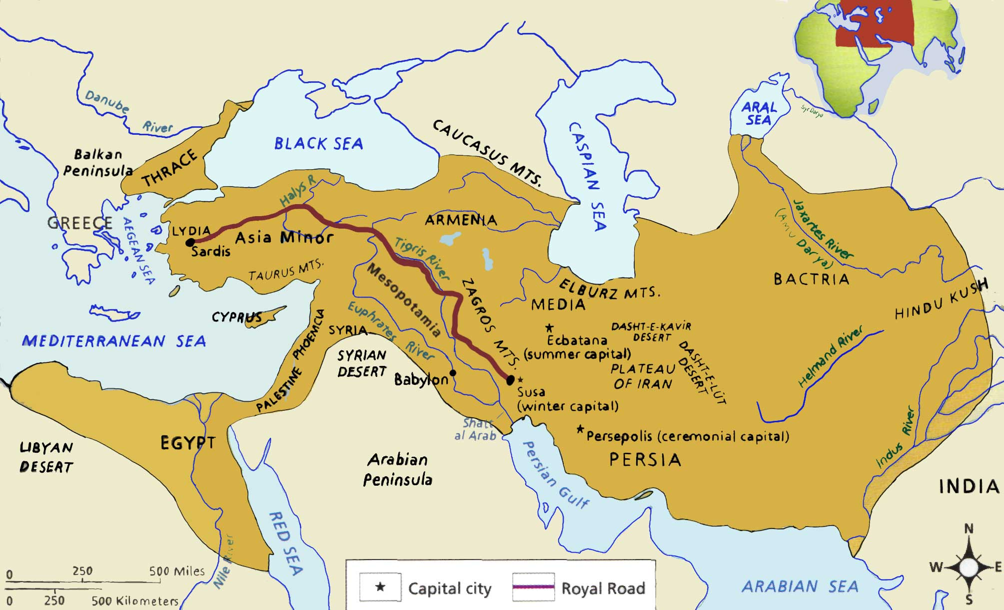

Slide 12
Your Homework – Greco-Persian War Timeline
Founding of the Delian League | Battle of Thermopylae | Peace of Callias
Battle of Marathon | Ionian Revolt | Battle of Plataea
Create an accurate timeline using ALL six events above relating to the Greco-Persian War on an A4 paper
  Include Event Names
  Include Year(s) for each event
  Write a 1-paragraph summary (in your own words) for ONE of the events from the timeline at the bottom of the page
Be aware that for BCE dates, year decreases as it moves to the right

Slide 13
It may be beneficial for you to write these down…
Vocabulary
Tragedy
Peloponnesian Wars
Macedonian Empire
Alexander the Great
Hellenistic Period
Questions to Consider
Why was the Peloponnesian War ultimately terrible for both the Athenians and Spartans?
Who was Alexander the Great and why was he considered “great”?
What defines the Hellenistic Period?
Name one major achievement of Classical Greece

Slide 14
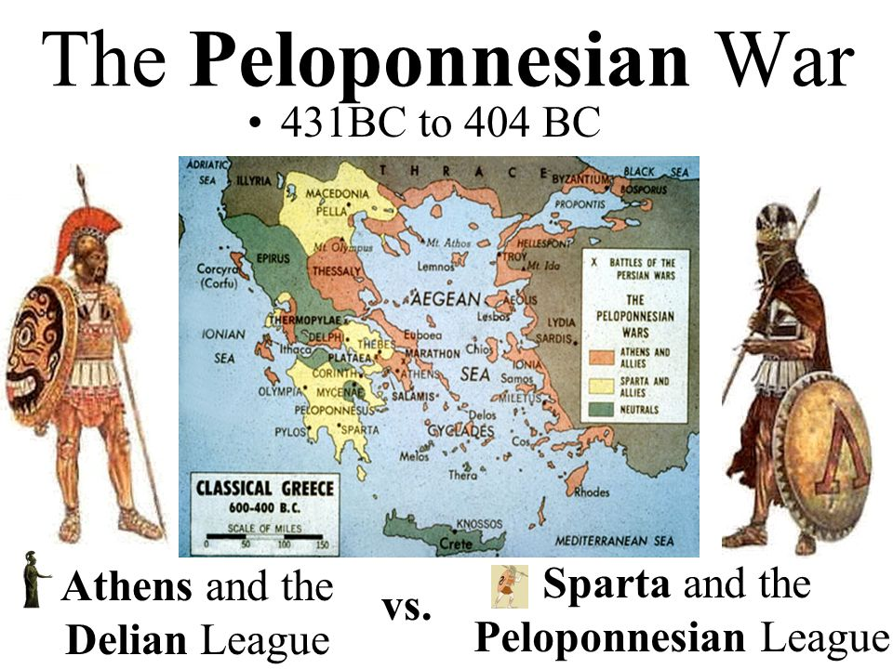
Peloponnesian Wars (431-404)
The Sparta had fears that Athens was growing too strong
  Athens had created defensive barriers after the Greco-Persian War around their empire
    Not only for protection against Persia, but also against the Spartans

Slide 15
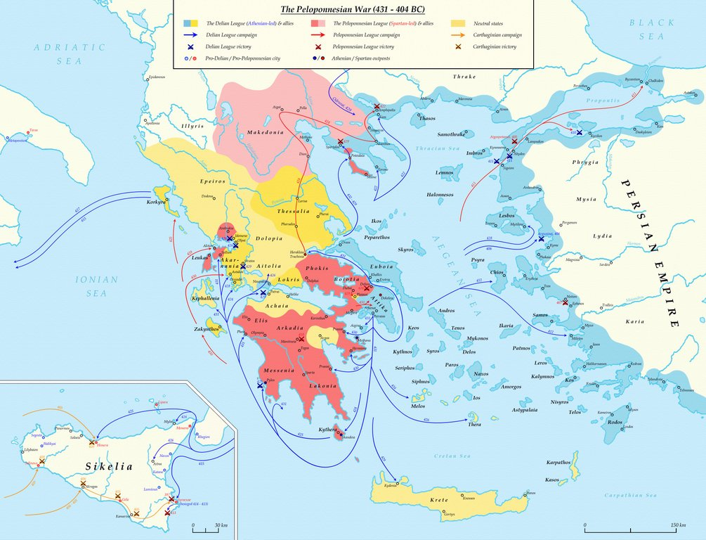
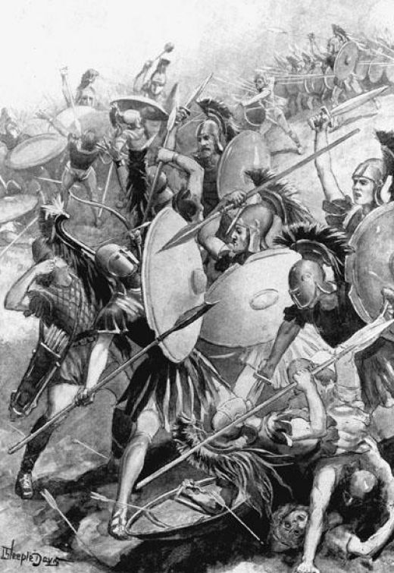
Peloponnesian Wars (431-404BCE)
First Peloponnesian War
  Athens fought and defended using their Navy
  Sparta fought by land
  Ended in a truce
Second Peloponnesian War
  Athens attempts to defeat one of Sparta’s allies and was defeated, ending the Athenian golden age
The Peloponnesian Wars were devastating to the various Greek city-states
  Loss of wealth, power, and men

Slide 16
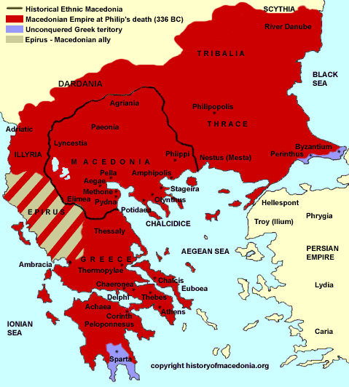
The Rise of Macedon
The northern Kingdom of Macedon grows in power
Phillip II (Alexander’s father) of Macedonia conquered most of Greece in 359-336BCE
  Macedonian Phalanx
Alexander takes over after his father’s death at the age of 20 as King
  Taught by Aristotle
  Takes over Persia
  Continues onwards towards India

Slide 17
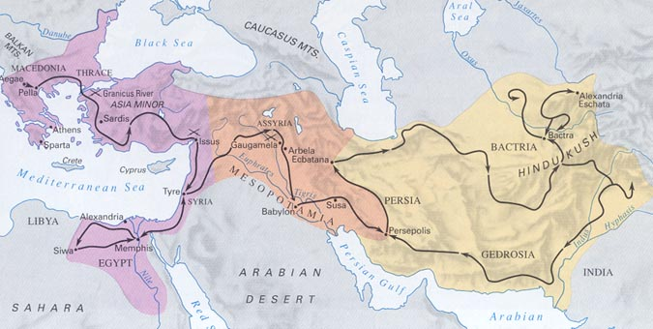
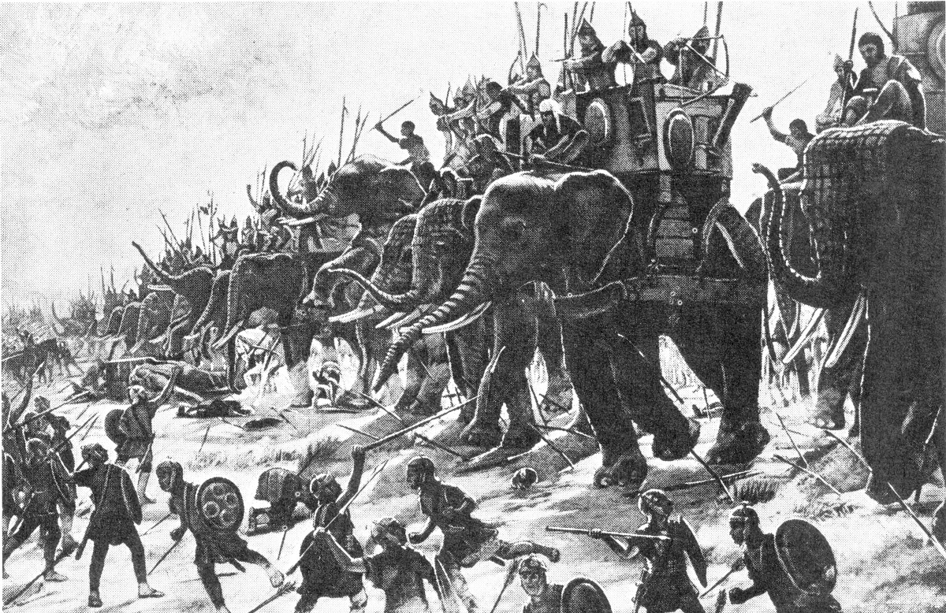
Alexander was able to expand his empire all the way to the western reaches of India (current day Pakistan) along the Indus River
  However, Alexander dies at the age 33 in 323 BCE
The culture of the territories Alexander expanded to forever changed in terms of the spread of culture
  Like the Persians, Alexander conquered, but allowed people to have their own control and religions in their areas. Much of Greek culture spread, though

Slide 18
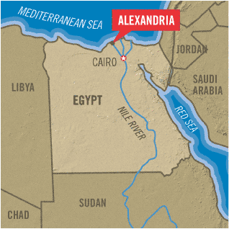
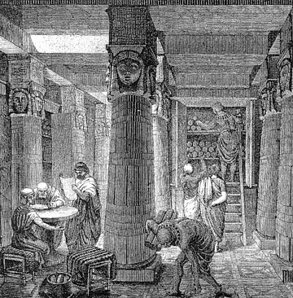
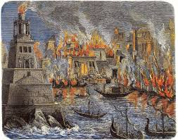
Library of Alexandria
Built in the city named after the famous conqueror in 300 BCE
  Alexandria, Egypt
Housed 40,000-400,000 scrolls
  Scholars came from all over to study at this library
It will be set on fire a few times, but finally destroyed around 6th century CE

Slide 19
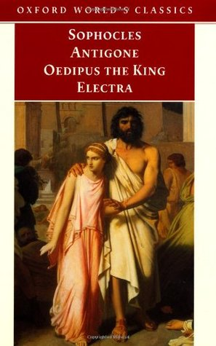
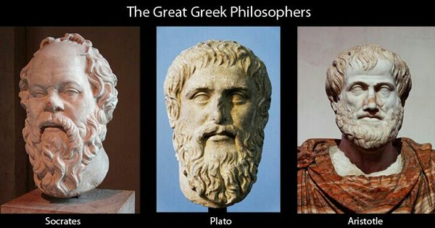
It housed and influenced works of Great Writers and Philosophers
Greek dramas and plays were store at Alexandria
  Sophocles’ famous plays like Oedipus Rex, Antigone, etc. Only 7 of 120 survive today
Philosophical works from great thinkers
  Socrates (“True knowledge exists in knowing that you know nothing”)
  Plato (“The measure of a man is what he does with power”)
  Aristotle (“It is the mark of an educated mind to be able to entertain a thought without accepting it”)

Slide 20
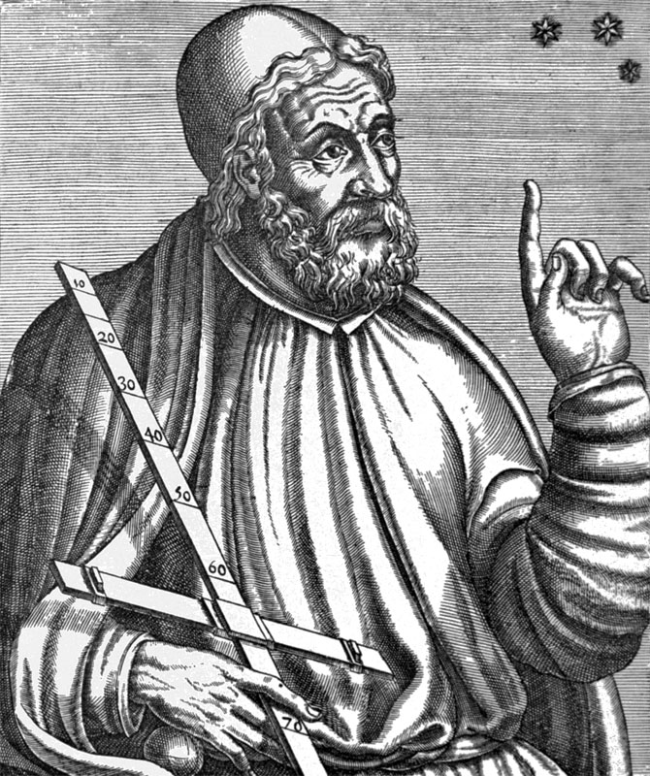
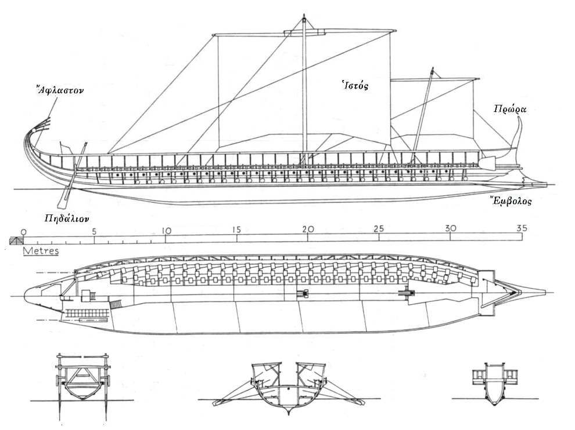
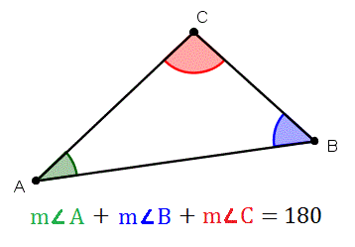
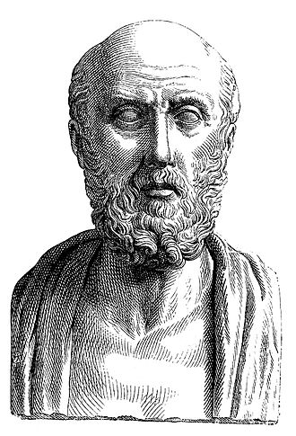
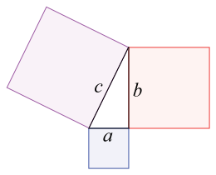
It housed and influenced works of Great Scientists and Mathematicians
Designs and technology
  Trireme*
Euclid - Founder of Euclidian Geometry
Pythagoras – Pythagorean Theorem
Medicine – Hippocrates & the Hippocratic Oath
  “First, do no harm”

Slide 21
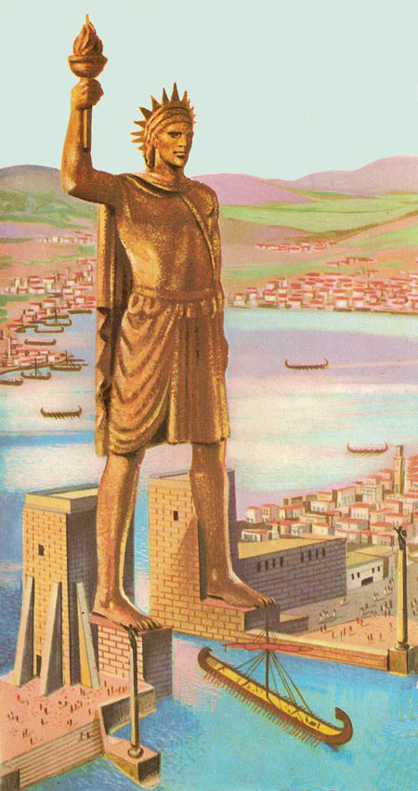
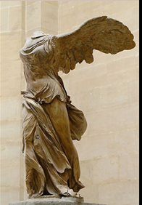
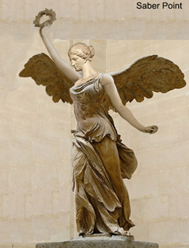

It housed and influenced works of Great Art and architecture
“The aim of art is not the outward appearance of things, but their inward significance” – Aristotle
Influences from all over territories conqueror by Alexander
  Colossus of Rhodes
  Winged Victory of Samothrace
Change to Hellenistic art styles

