Slide 1
SAT Reading

Slide 2
SAT Reading Portion
65 minutes, 52 questions (72 seconds/question)
No penalty for wrong answers
  Guess if you’re running out of time
Scoring: (reading/writing portion = 400/400 = 800pts)
  51-52 questions right = 98% correct = 400 score
  34-35 questions right = 65% correct = 300 score

Slide 3
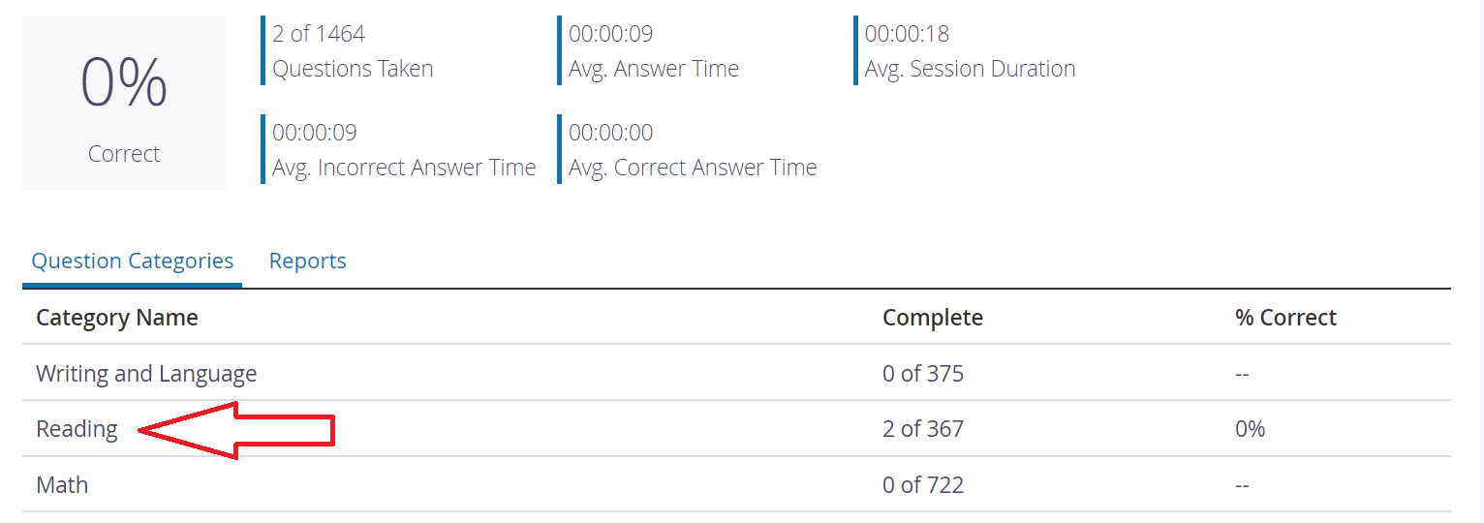
Naviance & Khan Academy
Please use the time to practice for the SAT
Naviance Test Prep and Khan Academy have good practice questions available
For our Reading Class:
  1 Practice Reading per day if possible

Slide 4
Our focus today:
Ways to tell style
Central Ideas
Observing the three styles of passages:
  Expository – Objective information w/ a guiding question
    “What happened at the Battle of Bull-Run?”, “How did the trireme change Greek warfare?”
    Ex. News articles, science textbooks, etc.
  Rhetorical – Author’s point-of-view (POV) around a thesis
    “Hiking is good for the soul”, “Dogs are a man’s best friend”
    Ex. Op-Eds, blogs, magazine articles, etc.
  Narrative – Fiction/Non-fiction story with a protagonist and a transformative struggle
    “King Lear fights to establish his legacy”, “Peter must determine whether he should join the side of the alliance or the rebels”
    Ex. Short stories, novels, biographies, etc.

Slide 5
First and Last Paragraphs
The first and last paragraphs usually help to determine what type of passage type it will be:
“Without some appreciation of common large numbers, it’s impossible to react with the proper skepticism to terrifying reports that more than a million American kids are kidnapped each year, or with the proper sobriety to a warhead carrying a megaton of explosive power—the equivalent of a million tons (or two billion pounds) of TNT.
And if you don’t have some feeling for probabilities, automobile accidents might seem a relatively minor problem of local travel, whereas being killed by terrorists might seem to be a major risk when going overseas. As often observed, however, the 45,000 people killed annually on American roads are approximately equal in number to all American dead in the Vietnam War. On the other hand, the seventeen Americans killed by terrorists in 1985 were among the 28 million of us who traveled abroad that year—that’s one chance in 1.6 million of becoming a victim . . .”

Slide 6
First and Last Paragraphs
  Things to look out for in last paragraph:
    Expository – Finishes explaining interesting fact
    Rhetorical – Provides a suggestion to the reader
    Narrative – A resolution happens at the end
Q: The primary purpose of this passage is to:
warn against the dangers associated with daily living in the United States
compare the costs of war-related activities to the costs of domestic activities
discuss common misunderstandings about statistical data
propose solutions to some problems in American domestic and foreign policy

