Slide 1
AP World History Prep
Sy16-17

Slide 2
Agenda
Pre-WWII
What’s happening in USSR (Russia)?
Rise of Japan
Germany/Nazi Aggression

Slide 3
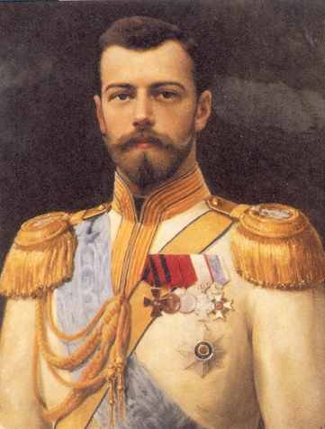

What’s happened in Russia/USSR?
Russian Revolution of 1917
End of Monarchy and establishment of the Duma (provisional gov’t)
Continues in WWI which becomes very unpopular (Russian losses were around 10 million lives)
Socialism vs. Communism
Socialism:
Economy controlled by society directly or through the government
Classless society
Communism:
Extreme socialism. Government will eventually need to overthrown

Slide 4
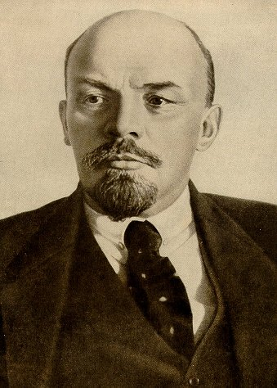
What’s happened in Russia/USSR?
Bolshevik party (Socialists) led by Vladimir Lenin
Overthrew with provisional government in November of 1917
Pulls Russia out of WWI with land losses to Germany in 1918
Still a civil war happening between Bolshevik’s (Red Army) and Mensheviks (White Army)
Defeats Mensheviks
Considers themselves a Communist state
“Peace, Land, Bread”

Slide 5
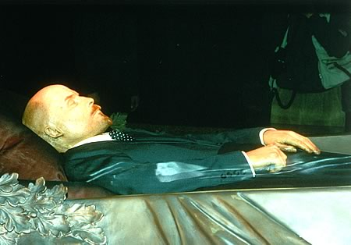
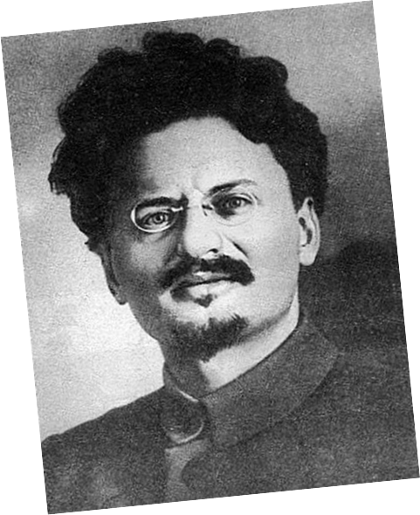
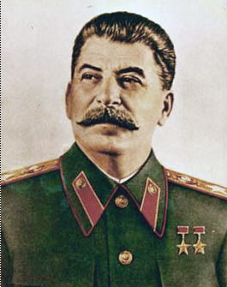
What’s happened in Russia/USSR?
Czar and family are killed
Secret Police established
Arrested and eliminated anyone who spoke bad about the government
Restricted the power of the church
Lenin rules until 1924 (his death)
Two people vied for power: Leon Trotsky and Joseph Stalin
Stalin outmaneuvered all of his political opponents
Trotsky fled to Mexico where he was assassinated
Stalin becomes leader of USSR in 1929

Slide 6
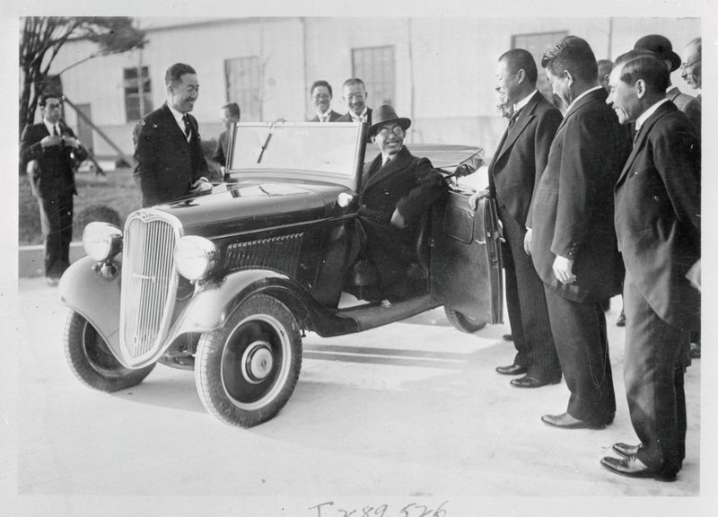
Rise of Japan
Prior to WWI, Japan was heavily influenced by western empires
Defeated the Russians, remember?
After WWI, Japan also suffers from Great Depression
Unemployment for 1 million Japanese
Central government of Japan attempts to nationalize and repair it’s own economy
Government financed businesses
Got unemployed people work
Spend money on making arms
Public works projects

Slide 7
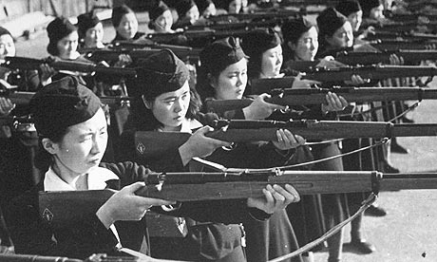
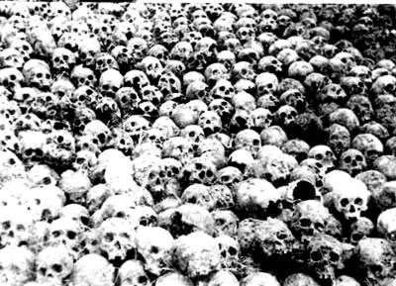
Authoritarian Japan
Took Japan out of depression, but also:
Military leaders in positions of power
Increased censorship
Trade unions banned
Textbooks change (pro-nationalist)
Believed Treaty of Versailles was unfair
Took control of Manchuria in 1931
Western powers were outraged
Japan leaves League of Nations
1937 – Japan invades China & French Indo-China
Rape of Nanjing

Slide 8
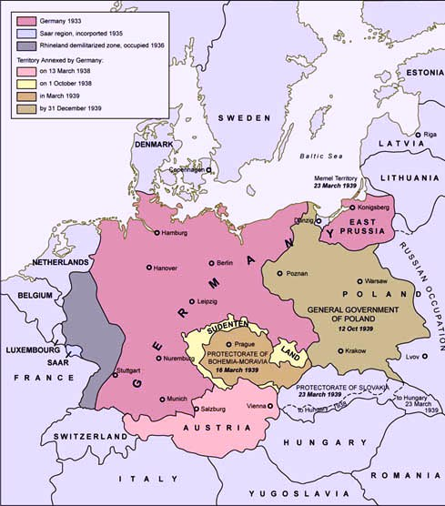
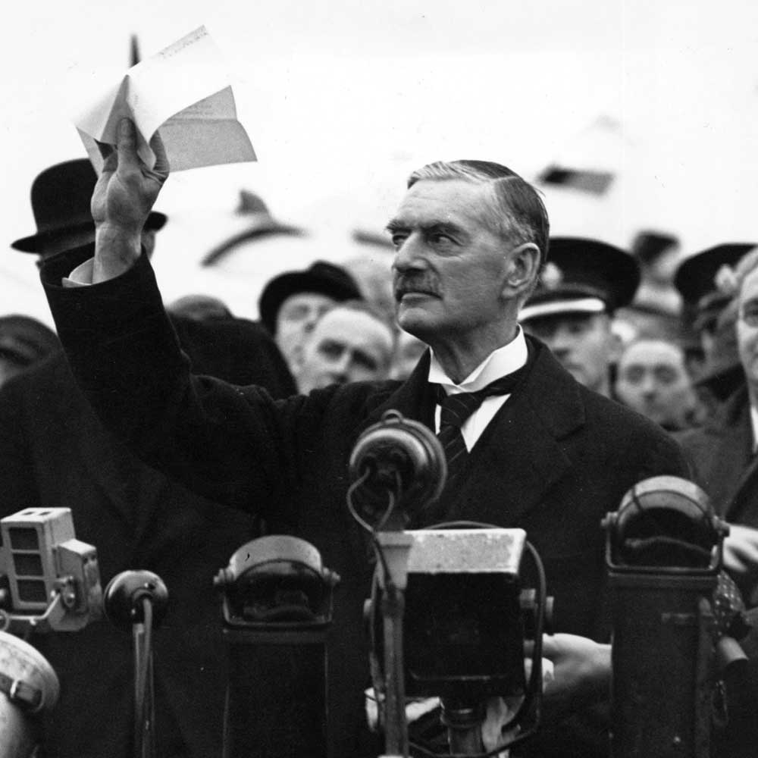
German Expansion
1936 – German troops move into the Rhine river valley
Breaks Treaty of Versailles
1938 – Germany annexes Austria & the Sudetenland
Munich Conference & Appeasement
Neville Chamberlain, “There will be peace in our time”

Slide 9
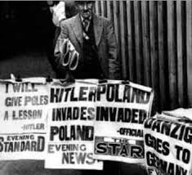
German Expansion
1939 – Nazi-Soviet non-aggression pact
September 1, 1939 – Germany invades Poland

