Slide 1
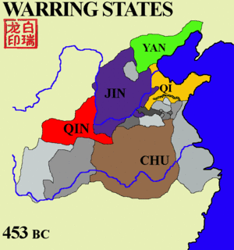
Warring States Period of the Late Zhou (490BCE – 221BCE) cont.
The late Zhou period had territories divided into 7 states by 334BCE
Qin, Han, Wei, Zhao, Qi, Chu, Yan (& some smaller states)
Eventually, King Zhao Zheng dominates and establishes a the Qin Dynasty in 221BCE

Slide 2
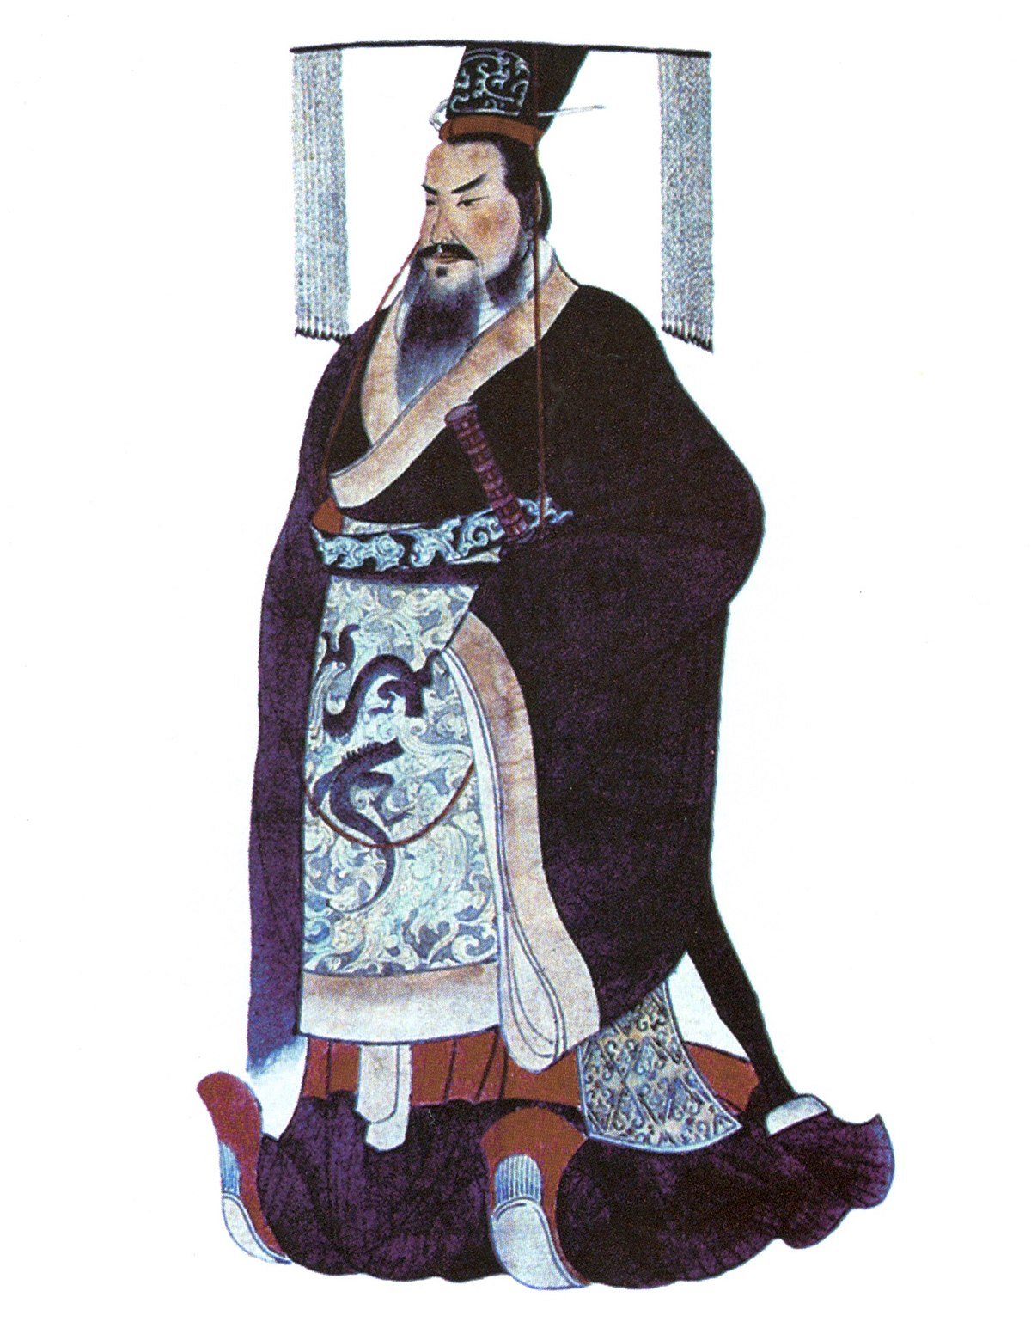
Qin Dynasty (221-206BCE)
秦
Zhao Zheng renames himself Qin Shi Huang [First Emperor of Qin]
Establishes Legalism as the philosophy of the land
Centralized government & harsh changes
The Emperor had major power
Destroyed relics of the past and killed many who disagreed with the philosophies
What is legalism’s criticism of the past?

Slide 3
Excerpt from “Records of the Grand Historian (Shiji)” by Sima Qian, 94BCE*
Chancellor Li Si Said: "I, your servant, propose that all historians' records other than those of Qin's be burned. With the exception of the academics whose duty includes possessing books, if anyone under heaven has copies of the Shi Jing [Classic of Poetry], the Shujing [Classic of History], or the writings of the hundred schools of philosophy, they shall deliver them (the books) to the governor or the commandant for burning. Anyone who dares to discuss the Shi Jing or the Classic of History shall be publicly executed. Anyone who uses history to criticize the present shall have his family executed. Any official who sees the violations but fails to report them is equally guilty. Anyone who has failed to burn the books after thirty days of this announcement shall be subjected to tattooing and be sent to build the Great Wall. The books that have exemption are those on medicine, divination, agriculture, and forestry. Those who have interest in laws shall instead study from officials."
*What can time context tell us about possible biases?

Slide 4
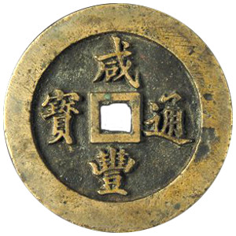
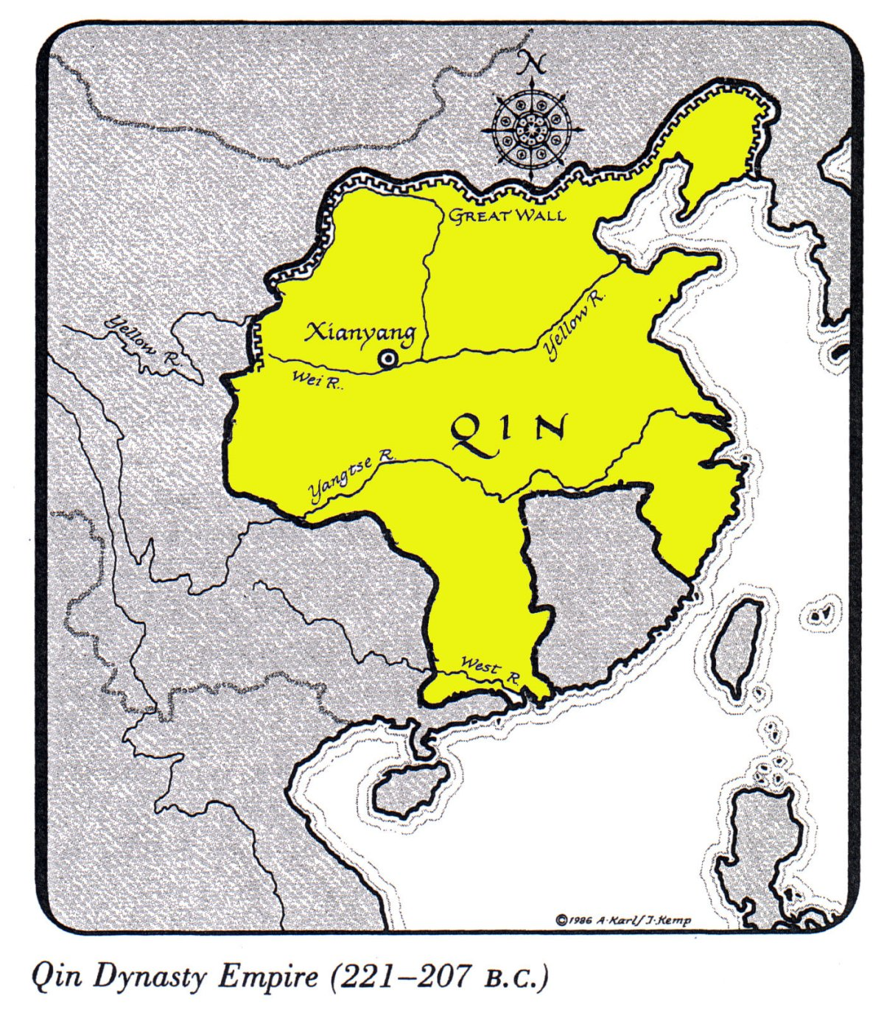
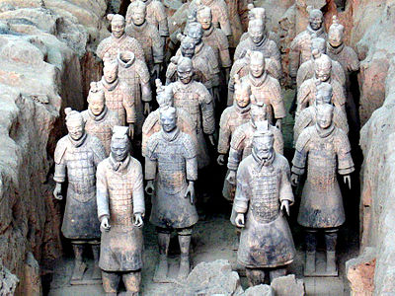
Achievements of the Qin Dynasty
Qin Empire expanded quickly
Standardized coinage and currency
Construction Projects
Start of The Great Wall (originally as protection from northern tribes)
Building of roads
Terracotta Army

Slide 5
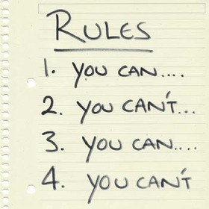
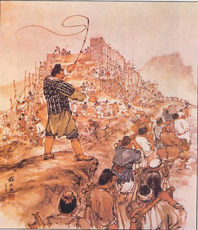

Decline of Qin Dynasty
Heavy taxes of citizens
Costs of large government, large armies, and construction projects
Harsh rule and strict rules
Legalism irritated the people
Weak successor
Qin Shi Huang dies from mercury poisoning
His son, Qin Er Shi, ruled only three years before he committed suicide in 207BCE
Nationwide rebellions led to the overthrow of the Qin in 206BCE

Slide 6
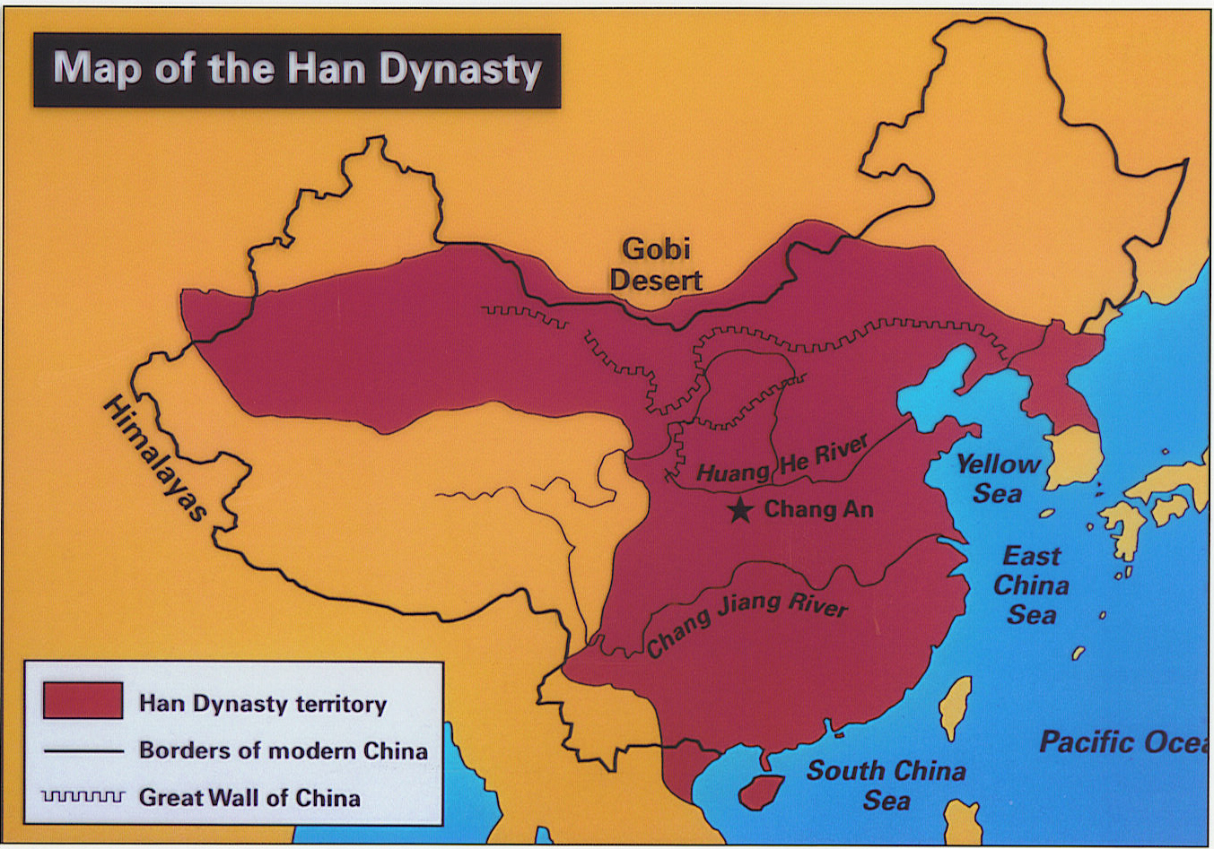
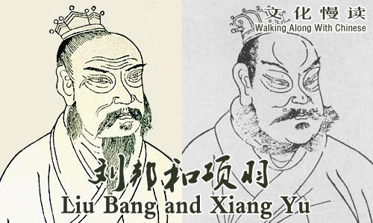
Battle for China: Xiang Yu vs. Liu Bang [v]
In a series of battles, Xiang Yu and Liu Bang brought their armies against each other
Both were former allies fighting against the Qin, but there can only be one ruler of China
Both fought to control China after the fall of the Qin
Liu Bang succeeded and defeated Xiang Yu in 202BCE

Slide 7
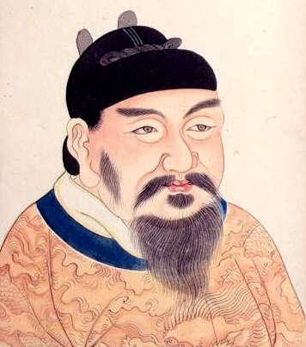
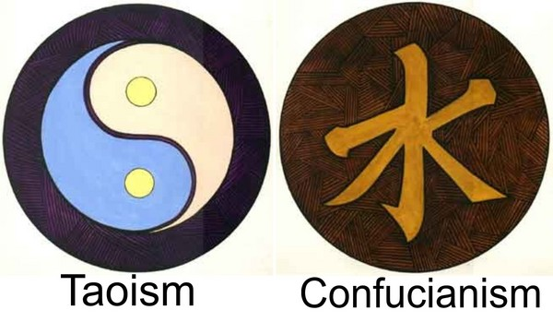
Han Dynasty (206BCE – 220CE)
汉
Emperor Gaozu (formerly Liu Bang) establishes the Han Empire
Peasant Background
Was said to have come from humble beginnings and grew his reputation
Centralized Government
Similar to Qin, no?
Criticized and removed Legalist ideas
Why is this a popular move for Gaozu?
Re-establishes Confucian and Daoist practices

Slide 8
Han Dynasty Social Structure
Social structure from Most to Least powerful
Questions:
Where are the soldiers?
Farmers were typically conscripted to fight one month out of the year
Why are we not using a pyramid?
Because the population distribution is not proportional (ex: slaves made up only 1% of population)
How is this social structure similar to the structure of the Early Zhou?
Farming was seen as a more respectable profession (than Artisans and Merchants) as they helped feed the 60 million Han people
Remember ‘peasant’ Liu Bang?
Emperor
Royalty and Royal Family
Farmers
Scholars and Officials
Artisans and Merchants
Slaves

Slide 9
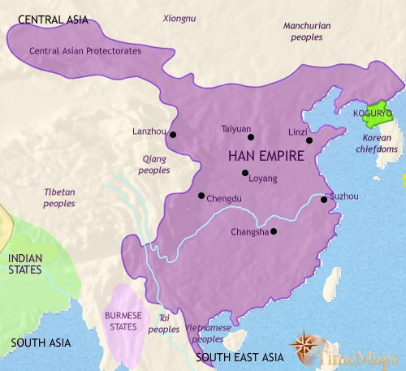
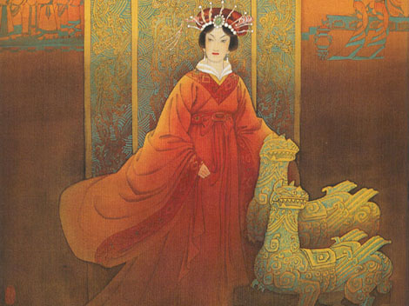
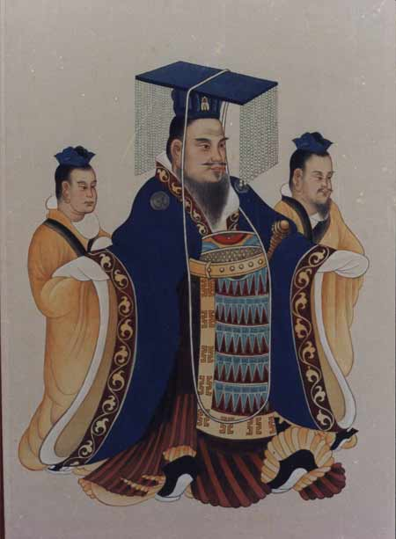
Gaozu’s Successors
His wife, Empress Lü, became Empress Dowager in 195 BCE after Gaozu’s death
Rumored to have ordered the deaths of Gaozu’s favorite concubine and their son (poison)
Had much influence over her son’s rule
His great grandson, Wudi, reigned from 141 – 87 BCE
Fought off the Xiongnu tribes of the north
Established colonies in present-day Vietnam, Korea, and central Asia

Slide 10
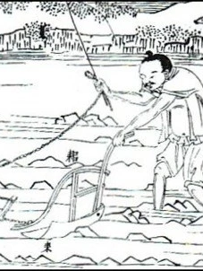
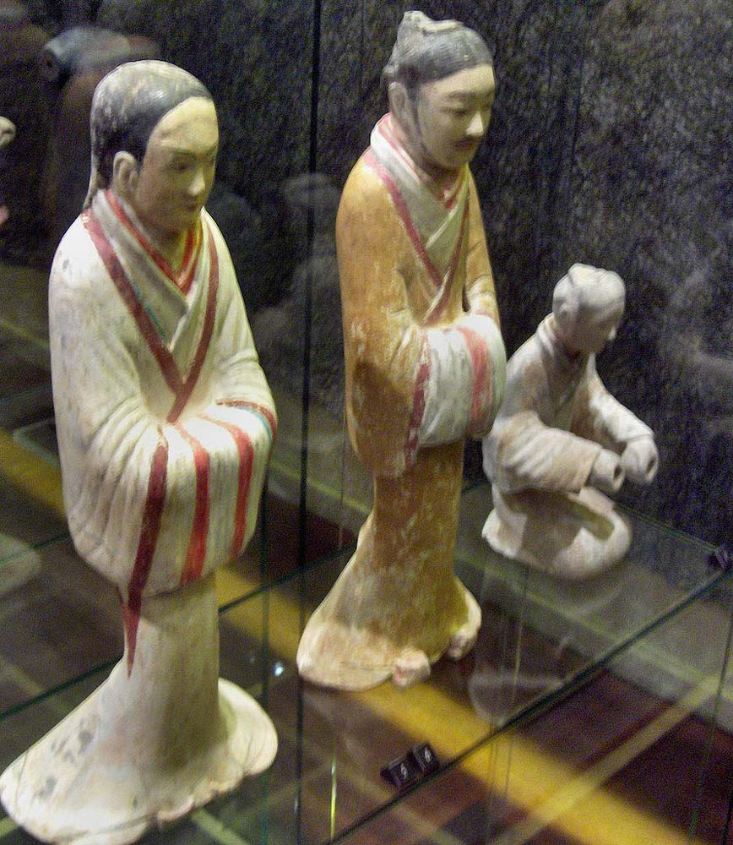
Han Problems: Economy
Wealthy people tended to be landowners and nobles
Some didn’t have to pay taxes because they were friends or family to royalty
Farmers typically tenant farmers and didn’t own land
50% of their income went to paying the nobles
Han Dynasty’s Inheritance Law
Land is divided amongst the male heirs
Over time, plots of lands became smaller and smaller; farmers could not grow much but were still taxed heavily
Salt and Iron monopoly (gov’t controlled all)
Industries (merchants, farmers, laborers, military, etc.) using salt and iron had to pay set prices
Reduction in quality of items

Slide 11
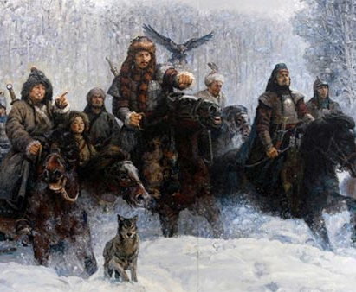
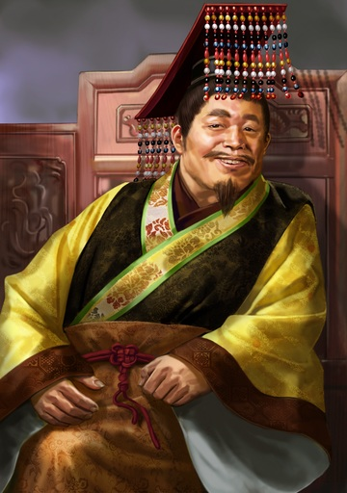
Han Problems: Invasions and Weak Rulers
The nomadic Xiongnu tribes of the north kept attacking the borders of Han Empire
Other tribes like the Uighers and Kazahks of the west, and the Mongols and Jurchens of the north and northeast
Weak Emperors of the Han create decline in the Empire
Emperor Yuan (48-33 BCE) brought Confucianism into Han but was extremely indecisive
Emperor Ling (168-189 CE) lived a decadent lifestyle and didn’t want to be Emperor

Slide 12
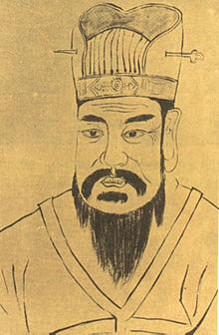
Wang Mang and the shortest-lived Chinese dynasty
Wang Mang was the nephew of the Grand Empress Dowager
Was the regent to Emperor Ping, the 9-year-old Han Emperor, in 1CE
Ping dies in 5CE, and Wang Mang serves as acting emperor
Becomes Emperor of the Xin Dynasty in 9CE
Wang Mang’s rule splits the Han into two periods:
The Western Han (206BCE – 9CE)
The Eastern Han (25CE – 220CE)

Slide 13
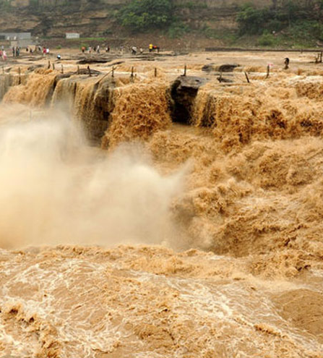

Xin Dynasty: Wang Mang doesn’t have the mandate of heaven
Economic Problems
Tried to create more money to pay for high costs of Empire but ends up creating an inflation (money becomes devalued)
Tried to feed the poor
But with what money?
Land Inheritance Reform
Attempts at redistribution of lands marks Wang Mang as an enemy to the aristocratic land owners
Discontinued tributes to the invaders
Not sending gifts to the Xiongnu and other tribes meant more attacks on the people (peasants)
The flood of the Yellow River in 11CE led to the lost of homes and businesses but also deaths due to disaster and famine

Slide 14
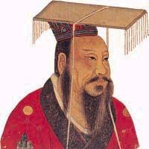
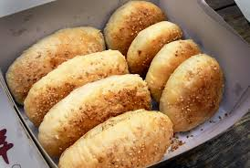
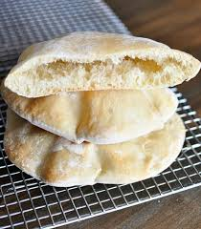
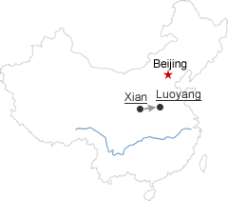
End of Xin and the Eastern Han
Rebellions arise all over China during the Xin Dynasty
In 23CE, Wang Mang is assassinated in Weiyang Palace
In 25CE, the Han Dynasty was re-instituted under Emperor Guangwu (Eastern Han)
The capital was moved from Chang’an to Luoyang
Food(V)
It is said that the ‘shaobing’ was brought from military expansion of China towards Central Asia
The diet of the Han peoples consisted of wheat, rice, barley, millet, and beans
Middle-Eastern Pita bread for comparison

Slide 15
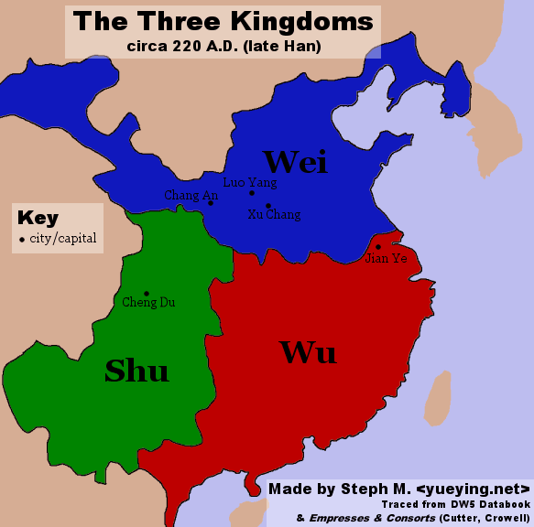
End of the Eastern Han
Unfortunately, the same economic problems will continue to persist which will lead to the end of the Han in 220 CE
China will be broken into the Three Kingdoms of Wei, Wu, and Shu

Slide 16
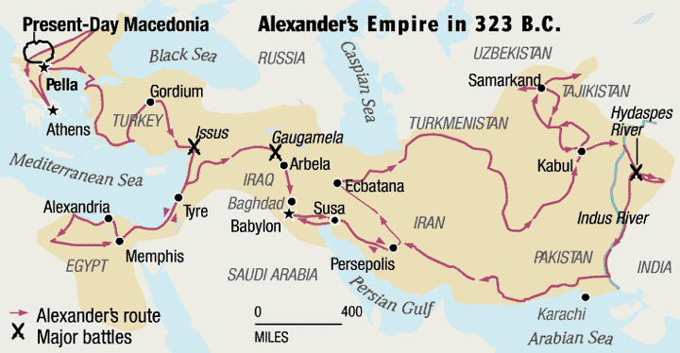
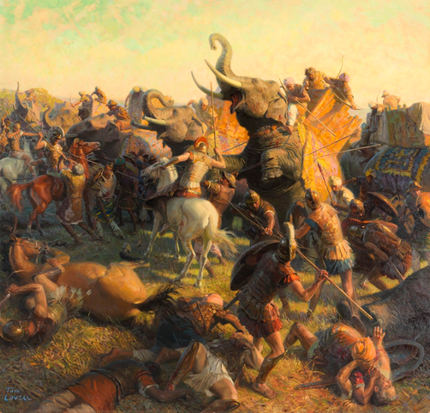
Some Foreign Historical Context
Alexander the Great reached the Indus Valley in 326 BCE

Slide 17
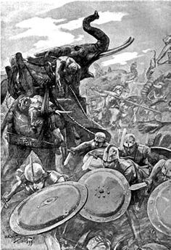
Indian Empires: Mauryan Empire
In 321 BCE, Chandragupta Maurya seizes military power by killing the former ruler of Magadha
Also fought against Seleucus in 305-303 BCE (a general of the Greeks) and drove them out of the Indus Valley and united northern India

Slide 18
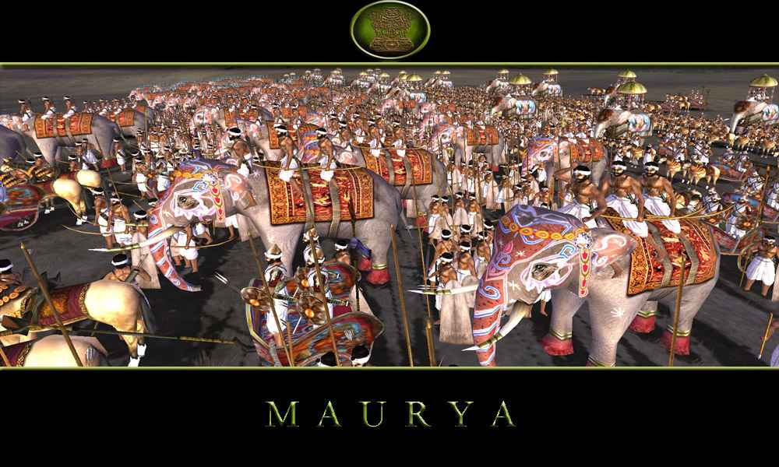
Indian Empires: Mauryan Empire – Military Might
600,000 foot soldiers
30,000 cavalry
9,000 elephants

Slide 19
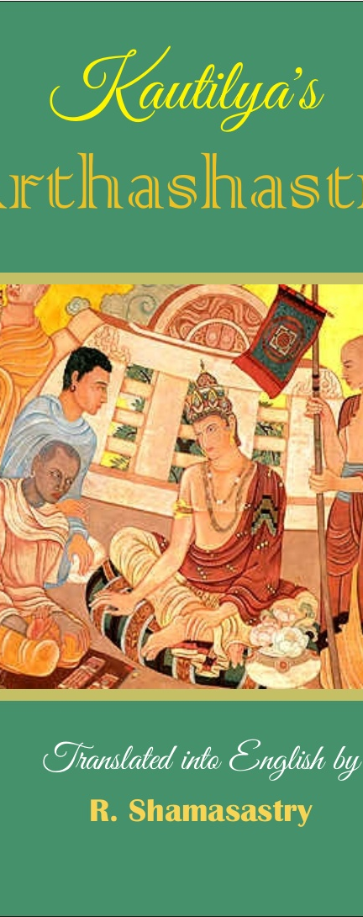
Indian Empires: Mauryan Empire – Bureaucracy
“To undermine a ruling oligarchy, make chiefs of the [enemy's] ruling council infatuated with women possessed of great beauty and youth. When passion is roused in them, they should start quarrels by creating belief (about their love) in one and by going to another.” – Arthasastra 11.1
Government was divided into four sections
A prince controlled each section
Local areas controlled by officials
Collecting taxes, enforcing laws
Arthashastra – The Ruler’s Handbook, written by Kautiya: advisor to Chandragupta
Advised those in charge to be ruthless
Argues that spying on one’s own people is important
Political assassinations are mentioned as well

Slide 20
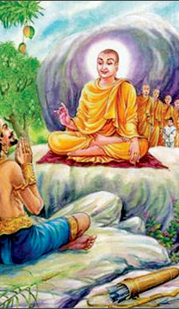
Indian Empires: Mauryan Empire – Asoka
In 269 BCE, Chandragupta’s grandson, Ashoka, takes the throne
In the Battle of Kalinga, 100,000 soldiers killed
Even though it was a victory, Ashoka converted to Buddhism over the lost of so many men
Asoka built stone pillars with new policies
Fair and equal treatment of subjects
Religious toleration
Importance of all life
Built roads and rest houses for travelers

Slide 21
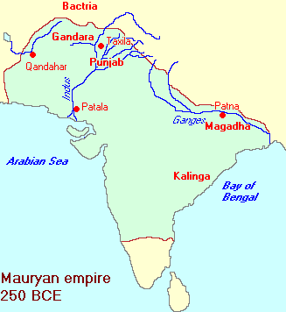
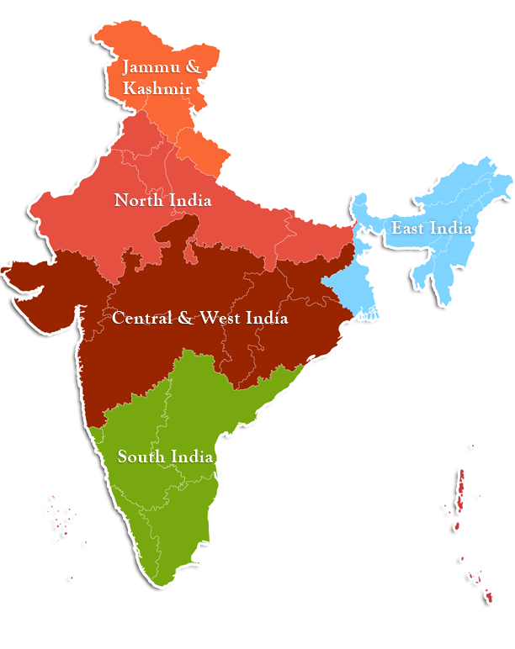
Indian Empires: Mauryan Empire – Decline
Asoka’s death left a power vacuum
Mauryan Empire breaks apart 185 BCE
Northern India
New people, languages, and customs from people from all over Asia
Central India
Andha Dynasty focused on trade with the North and South of India
Southern India
Three Tamil Kingdoms who fought one another
Spoke their own Tamil languages

Slide 22
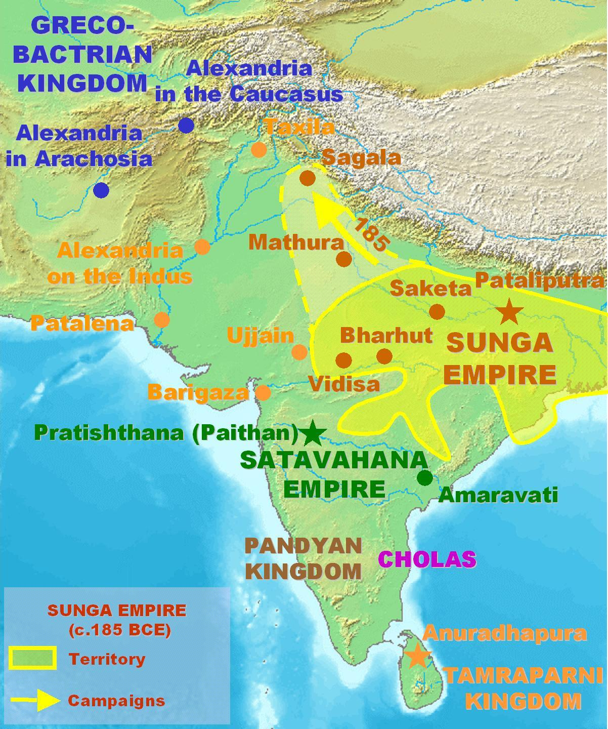
The In-Between
The 500 years between Mauryan and Gupta empire sees changes in the landscape of India
Many people vie (compete) for power after the fall of the Mauryan Empire
Greco-Romans from the West
Nomadic tribes from then North and Northeast
Divided kingdoms of the South
Diversification of religions, ideas, and trade from Silk Road continued

Slide 23
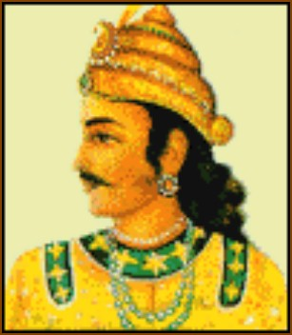
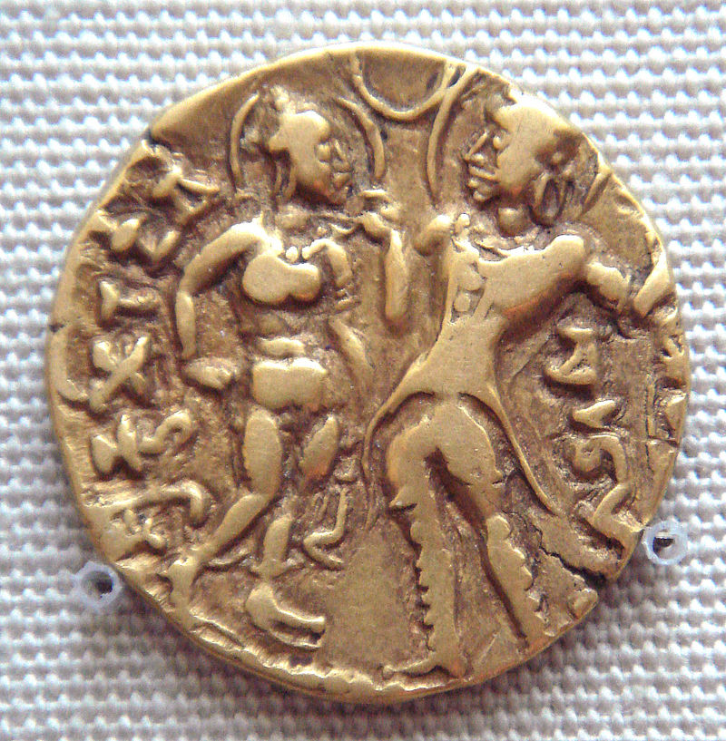
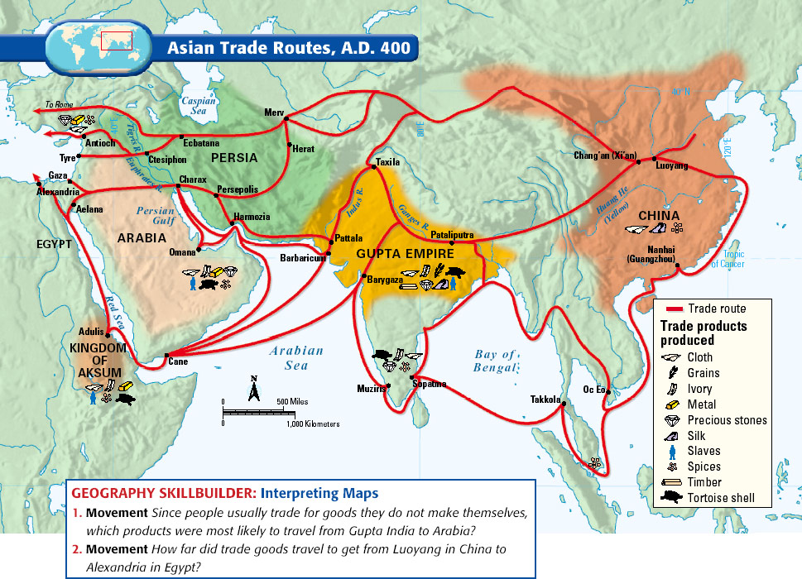
Gupta Empire (320 – 550 CE)
Chandra Gupta forms the Gupta Empire in 320 CE
Formed a strong alliance by marrying princess Kumaradevi, who is from a strong local tribe (Licchavi)
What factor (based on the map on the left) contributed to the success of the territories controlled by the Gupta Empire?

Slide 24
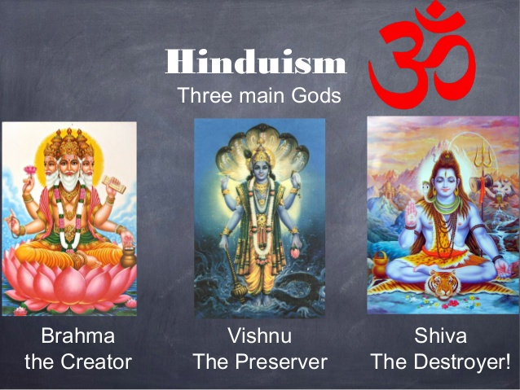
Gupta Empire – Hinduism and Theater-State
The re-emergence of Hinduism as the main religion in the Gupta Empire
Focus on the main gods (Brahma, Vishnu, Shiva)
The focus on the main gods allowed for easier direction
Brahmin priests became part of the elite and wealthy class
Theater-state
The Gupta Empire focused on creating elaborate rituals and ceremonies which were performed at the capital
In is way, the culture of the capital influenced the surrounding territories which also began to follow similar styles
Religious tolerance
Hinduism, Buddhism, and Jainism (amongst other religions) were allowed to be practiced
“The royal palace and halls in the midst of the city, which exists now as of old, were all made by spirits which [King Ashoka] employed, and which piled up the stones, reared the walls and gates, and executed the elegant carving and inlaid sculpture work – in a way which no human hands of this world could accomplish” – Faxian 400CE

Slide 25
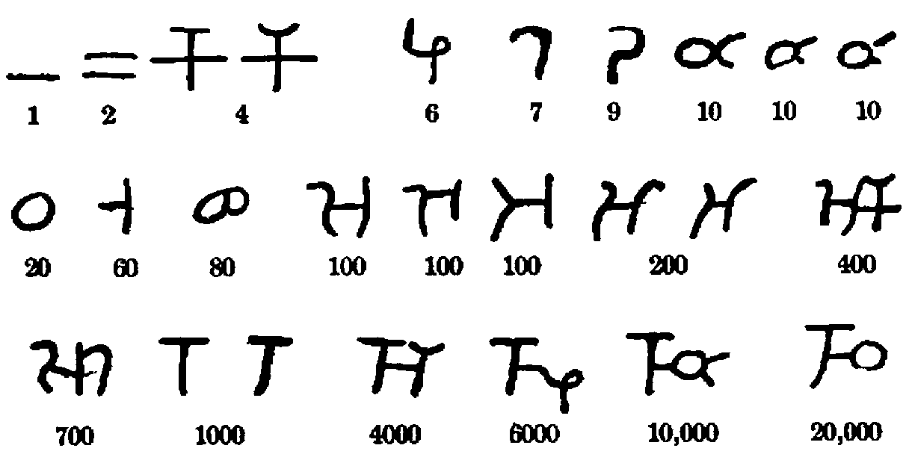
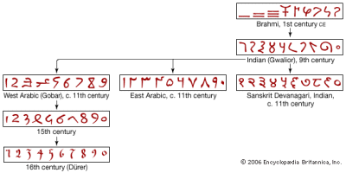
Math, Science, Art during Gupta Empire
The Empire supported and funded the sciences and arts
Math
The concept of zero
Zero important to the conception of time based on Hindu religion
Concepts of time go into the millions, billions, and trillions of years
The concept of base ten
Evolution of symbols to Arabic style which leads to modern style

Slide 26
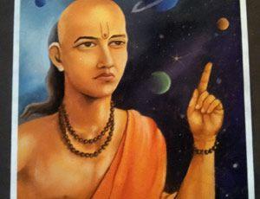
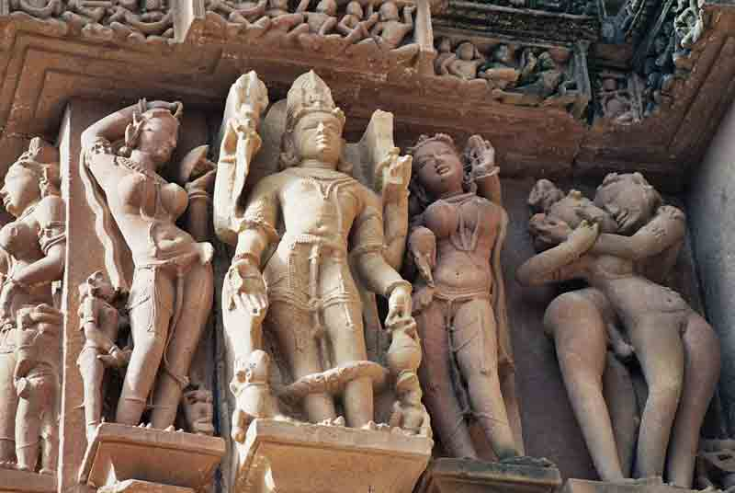
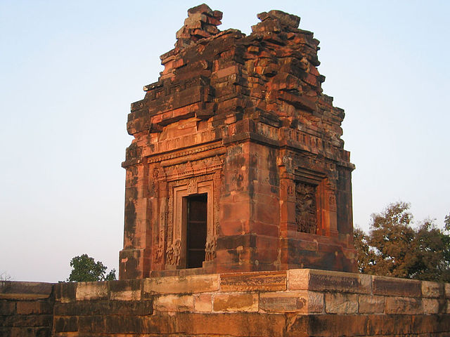
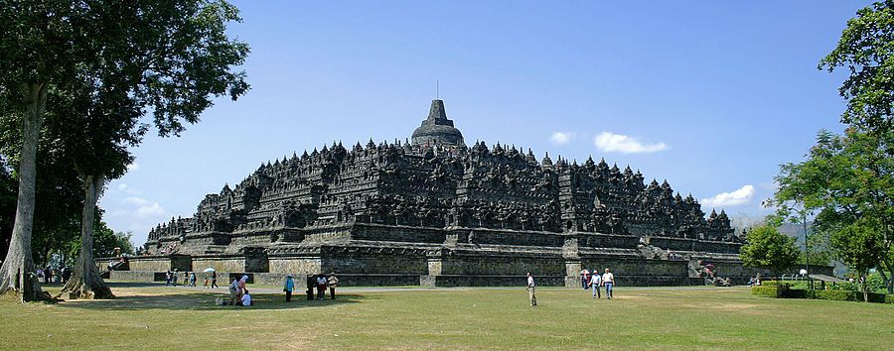
Math, Science, Art during Gupta Empire
Sciences
Aryabhata estimation of the roundness of the Earth and how it rotates around the sun
Calculated that the year would round about in 365 days
Predicted lunar and solar eclipses
Art and Architecture

Slide 27
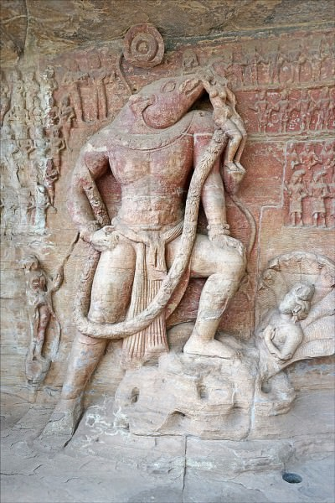
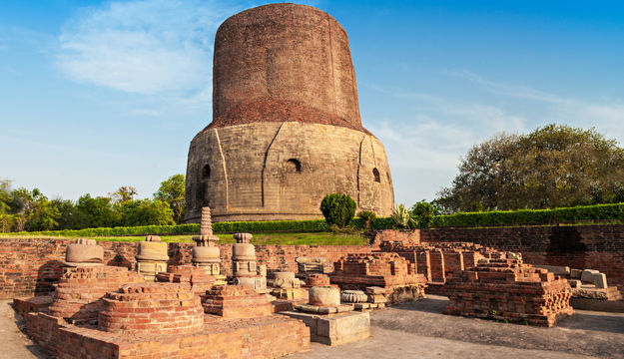
Art and Architecture
Dshavatara Temple
Udayagiri Caves
Dhamek Stupa

